Slide 1

Coal Genesis and Characterisation
Dr. B. K. Prusty
Assistant Professor
Department of Mining Engineering
Indian Institute of Technology Kharagpur

Slide 2
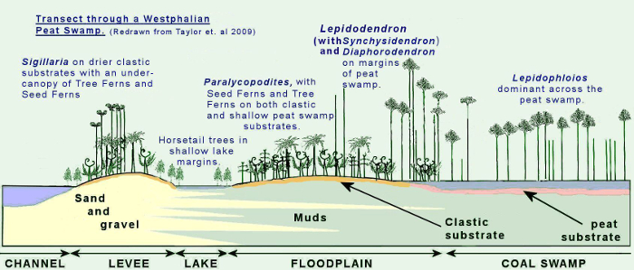
Coal is a Fossil Fuel.
Organic sedimentary rock which forms from the decay of plant materials such as moss, ferns and parts of trees (dried out peat bogs) in a swampy environment.
Most favorable conditions : 360 million to 290 million years ago, during the Carboniferous age.
In swampy environment - low in O2→ Anaerobic bacteria start decomposing the OM→ decomposition stops when the plants have been converted to peat
Source http://www.geologyatsheffield.co.uk/sagt/palaeoecology/

Slide 3
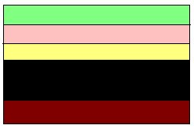
Formation and evolution of Peat.
Swamps are areas where organic matter from plants accumulate. As the plants die and get buried they compact to become peat. With time and more compaction, almost all of the water is lost and three different grades of coal result.
Peat
Burial
Compaction of the peat due to burial drives off volatile components like methane and water, eventually producing lignite .
Compaction
Soft brown coal which consist of about 40% carbon and do not burn efficiently.
Lignite Coal Seam
Burial

Slide 4
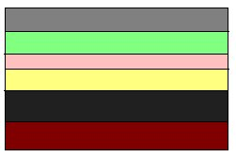

Burial
Further compaction and heating results in a more carbon- rich coal called bituminous coal.
Compaction
Consist of about 85% carbon and burns readily but produces a lot of smoke.
Bituminous
Metamorphism
If the rock becomes metamorphosed, a high grade coal called anthracite is produced.
Burial
Hard dark coal which consist of 90% to 95% carbon and burns very clean.
Anthracite coal produces the most energy when burned.
Anthracite Coal Seam

Slide 5
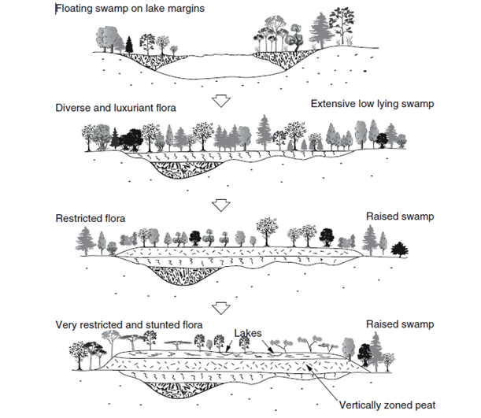
Peat formation can be initiated by:
Terrestrialization: replacement of a body of water by a mire
Paludiﬁcation: replacement of dry land by a mire, due to a rising groundwater table
From McCabe (1984)

Slide 6
Composition of Coals
Constituents of coal can be divided into two groups:
(i) the organic fraction/maceral, which can be further subdivided into microscopically identifiable macerals; and
(ii) the inorganic fraction/mineral matter, which is commonly identified as ash subsequent to combustion.
The organic fraction can be further subdivided on the basis of its rank or maturity.

Slide 7
MacerAL GROUPS
Three maceral groups: vitrinite, liptinite, and inertinite
Vitrinite: Most abundant maceral of coal
main contributor to the shiny black strands so familiar in coals.
Formed from lignin, cellulose, woody parts
Capable of producing hydrocarbon gas but only small amounts of oil
Liptinite : originates from spores, pollen, resins, algae, fats, bacterial proteins, and waxes
Many of the volatiles, including methane, emitted by the coal comes from the liptinite. These macerals have the potential of producing hydrocarbon gases and oil.
Inertinite: oxidized or charcoaled cell walls or trunks of plants, resulting in high carbon and aromatic content but less hydrogen.
Has relatively more carbon than the other macerals.
Only small amounts of volatiles are generated by the inertinites. No potential of these macerals to produce hydrocarbons.

Slide 8
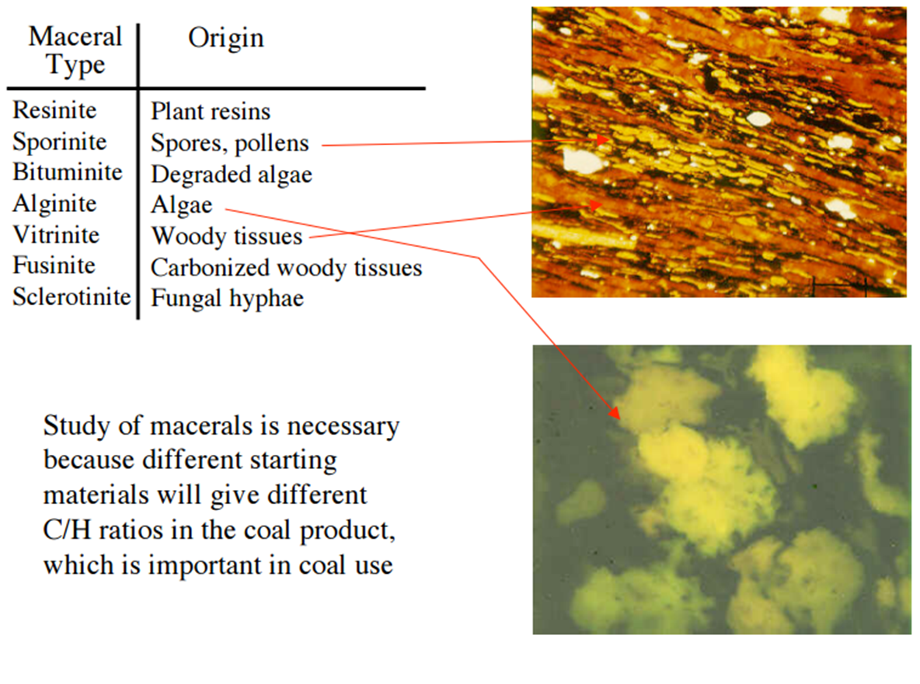
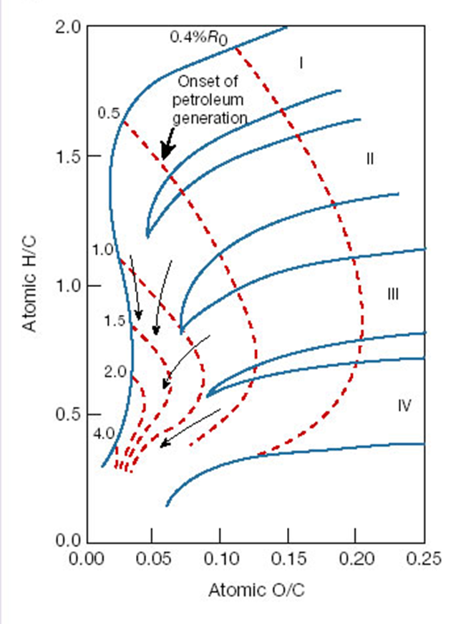
Van Krevelen diagram showing the chemical evolution of immature kerogen of varying composition (type I, II, III and IV) at increasing levels of thermal maturity
Source: Organic–inorganic interactions in petroleum-producing sedimentary basins , Jeffrey S. Seewald
http://www.its.caltech.edu/~chem2/Slides_Lecture2.pdf

Slide 9
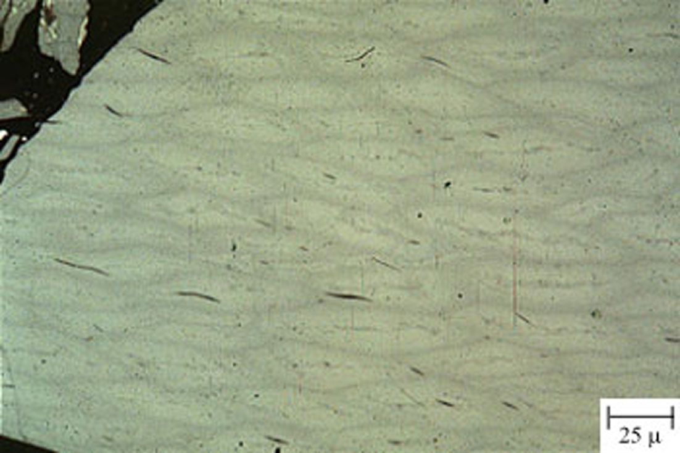
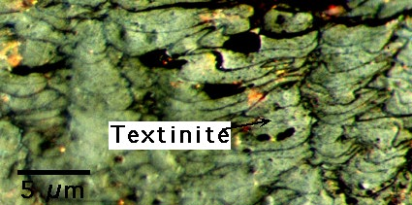
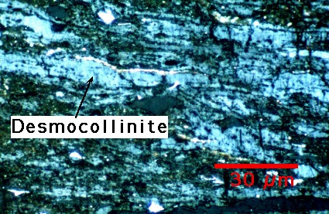
Vitrinite
Telocollonite Textinite Desmocollinite
Woody tissue of stems, branches, leaves and roots. Primary cell walls. Homogenous and banded.
Precipitated humic gels. Groundmass vitrinite. Slightly darker and slightly lower in reflectivity compared to telocollinite
Woody tissue of stems, branches, leaves and roots. Primary cell structure still distinguishable

Slide 10
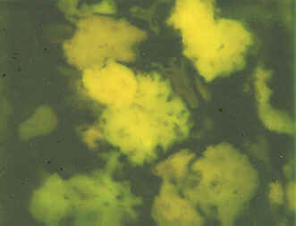
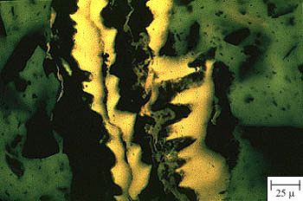
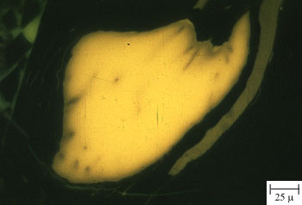
Liptinite
Alginite Cutinite Resinite
Marine and freshwater algae. Sub-macerals include Telalginite (individual and colonial algae) and Lamalginite (thin, laminar algae)
Waxy cuticles from plant leaves
Resins, fats and oils from plant bark, stems and leaves

Slide 11
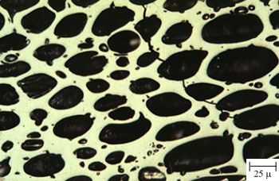
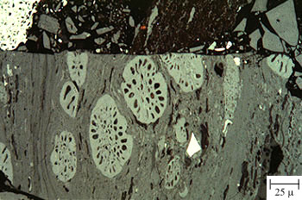
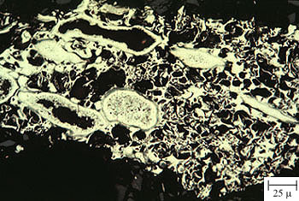
Inertinite
Fusinite Sclerotinite Semifusinite
Woody tissue aromatized during early coalification (charring, oxidation etc)
Fungal mycelia (spores). Possible product of oxidation of liptinite macerals.
Woody tissue partly aromatized during early coalification

Slide 12
Coal Classification
Two main ways for classifying coal - by rank and grade
Coal Rank : The degree of 'metamorphism' or coalification undergone by a coal, as it matures from peat to anthracite
Low rank coals, such as lignite and sub-bituminous coals, are typically softer, friable materials with a dull, earthy appearance; they have high moisture levels and low carbon content, and hence a low energy content.
Higher rank coals are typically harder and stronger and often have a black vitreous lustre.

Slide 13
Coal Classification
Lignite : lowest rank of coal
Browner and softer.
High oxygen content (up to 30 percent), a relatively low fixed carbon content (20-35 percent), and a High moisture content (30-70 percent)
Sub-bituminous coals : dull black and waxy.
Fixed carbon content between 35 to 45 percent and a moisture content of up to 10 percent.
Bituminous coals: dense black solids, containing bands with brilliant colors.
Carbon content of these coals ranges from 45 to 80 percent and the water content from 1.5 to 7 percent.
Anthracite: dense, hard and shiny
Having more than 86% fixed carbon and less than 14% volatile matter on a dry, mineral-matter-free basis.
Further divided into semi-anthracite, anthracite, and meta-anthracite groups based on increasing fixed carbon and decreasing volatile matter.
High carbon and energy content coupled with being a relatively hard material and clean burning makes anthracite a desired product.

Slide 14

Vitrinite: coal maceral→ determines coal rank
Used for a long time to estimate coal rank (= maturity)
Illumination of a vitrinite particle
Determination of the percentage of light that is reflected
The higher the maturity: the higher the reflectance value
Ro = 0.6 to 1.2 commonly cited as the principal zone of oil and gas formation

Slide 15
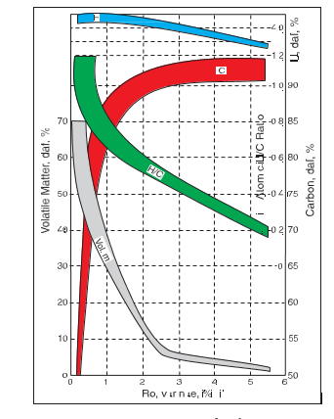
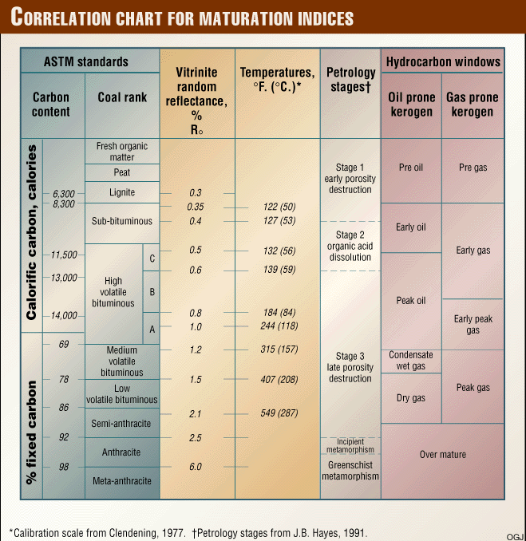
Changes in coal properties with increasing VRo
Source: http://www.ogj.com/articles/print/volume-97/issue-16l

Slide 16
Coal Classification: Grade
Classification as per use: coking coal and non-coking coal
Coking coal – use in steel making
Non-coking : Mostly for burning to produce power.

Slide 17
Coking coal grades
GRADES: The gradation of coking coal is based on ash content
Grade | Ash Content
Steel Grade –I | Not exceeding 15%
Steel Grade –II | Exceeding 15% but not exceeding 18%
Washery Grade –I | Exceeding 18% but not exceeding 21%
Washery Grade –II | Exceeding 21% but not exceeding 24%
Washery Grade –III | Exceeding 24% but not exceeding 28%
Washery Grade –IV | Exceeding 28% but not exceeding 35%

Slide 18
Grades of Non- Coking Coal
The gradation of non-coking coal is based on Useful Heat Value (UHV), and on ash plus moisture content.
Grade | Useful Heat Value (UHV) (Kcal/Kg) UHV= 8900-138(A+M) | Corresponding Ash% + Moisture % at (60% RH & 40^{O} C) | Gross Calorific Value GCV (Kcal/ Kg) (at 5% moisture level)
A | Exceeding 6200 | Not exceeding 19.5 | Exceeding 6454
B | Exceeding 5600 but not exceeding 6200 | 19.6 to 23.8 | Exceeding 6049 but not exceeding 6454
C | Exceeding 4940 but not exceeding 5600 | 23.9 to 28.6 | Exceeding 5597 but not exceeding. 6049
D | Exceeding 4200 but not exceeding 4940 | 28.7 to 34.0 | Exceeding 5089 but not Exceeding 5597
E | Exceeding 3360 but not exceeding 4200 | 34.1 to 40.0 | Exceeding 4324 but not exceeding 5089
F | Exceeding 2400 but not exceeding 3360 | 40.1 to 47.0 | Exceeding 3865 but not exceeding. 4324
G | Exceeding 1300 but not exceeding 2400 | 47.1 to 55.0 | Exceeding 3113 but not exceeding 3865

Slide 19
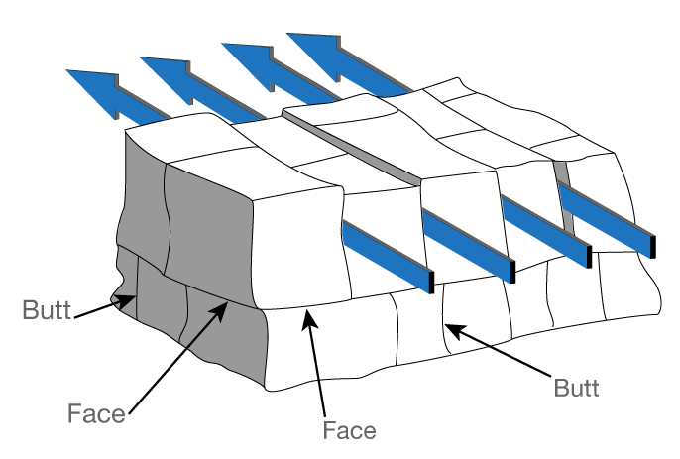
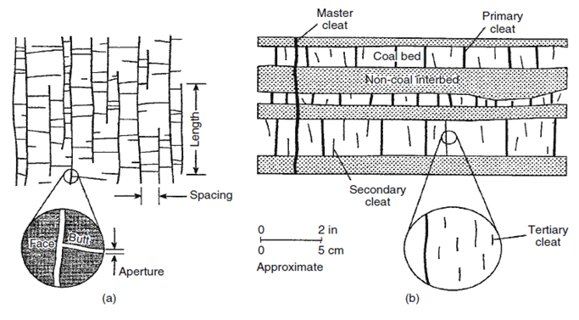
Cleats in coals
Cleats: form due to coal dehydration, local and regional stresses, and unloading of overburden.
Control the directional permeability.
Highly important for CBM exploitation through well placement and spacing.
Two orthogonal sets of cleats develop in coals perpendicular to bedding.
Face cleats are the dominant set →continuous and more laterally extensive; face cleats form parallel to maximum compressive stress.
Cleat spacing is related to rank, bed thickness, maceral composition, and ash content. Coals with well-developed cleat sets are brittle reflecting fracture density.
Cleats are more tightly spaced with increasing coal rank.
(a) Cleat-trace patterns in plan view. (b) Cleat hierarchies in cross-section view. (Laubach 1998).
Face and butt cleats in coal. (scott 1994).

Slide 20
Coal as a reservoir for coal bed methane
Coal Bed Methane is naturally occurring methane obtained by both biogenic and thermogenic process.
CBM contains small amounts of other hydrocarbon and non-hydrocarbon gases in coal seams as a result of chemical and physical processes.
It is formed during the conversion of organic material to coal, and eventually trapped in pores and cleats in the coal seam.
Organic matter is subjected to pressure and temperature, and further they are transformed into kerogen.
These kerogens with continuing pressure and high temperature starts to break down to produce gas (this is thermogenic methane) leading to an increase in carbon content and decrease in hydrogen content.

Slide 21
GENERATION OF GAS
STEP 1. TRANSFORMATION OF ORGANIC MATTER TO KEROGEN
PROTIEN, LIPID CARBOHYDRATE
MICROBIAL DEGRADATION
KEROGEN
AMINO ACID
POLYMERISATION
HUMIC ACID,HUMIN
INCREASING POLYMERISATION

Slide 22
Step 2. Kerogen to gas
KEROGEN
Shallow subsurface
Normal pressure and temperature
Released: CH₄, CO₂, H₂O
Overall decrease in O
Overall increase in H and C
DIAGENESIS
Deeper subsurface
Increased pressure and temperature
Released: oil & gas
Overall decrease in H and C
CATAGENESIS
METAGENESIS
Metamorphism
High temperature and pressure
Only C remains: becomes graphite
(Source: Hunt, Petroleum Geochemistry and Geology,1995)

Slide 23
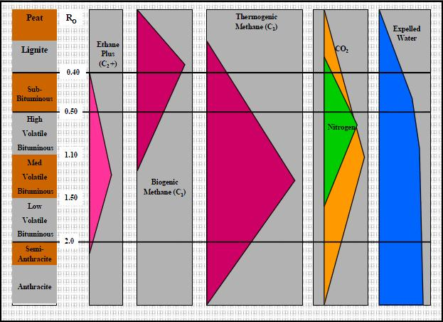
Coal maturation and gas generation chart.
Source: (ALL Consulting & Montana Board of Oil and Gas Conservation, 2003)

Slide 24
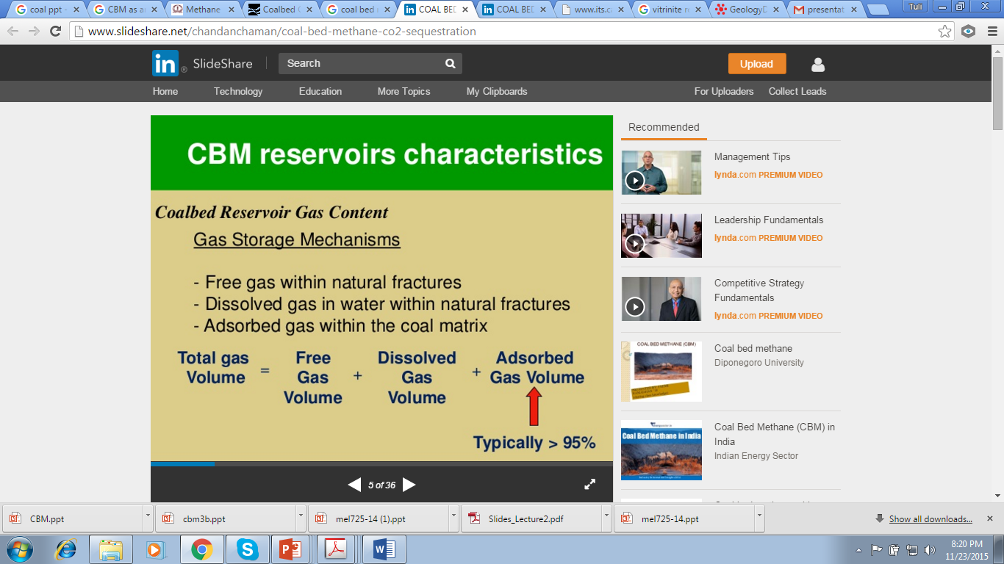
Storage
Coalbed methane is retained in coal in three ways:
As a free gas within the pore space or fractures in the coal;
As adsorbed molecules on the organic surface of the coal; and
Dissolved in groundwater within the coal.

Slide 25
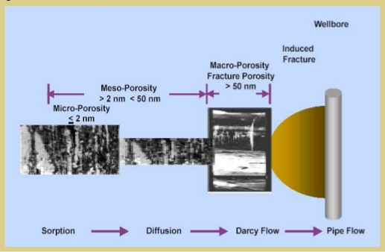
Porosity
Primary porosity→ Micropores
Secondary Porosity→ Macropores/fractures
Porosity in coals with carbon content (C) <75% is predominantly due to macropores;
Porosity in coals with carbon content (C) 85–91% is predominantly due to micropores;
Porosity in coals with carbon content (C) 75–84% is associated with signiﬁcant proportions of macro meso and microporosity.
Flow mechanism
Source: https://www.google.co.in/search?q=CBM+ppt

Slide 26
Transport of gas in coal
Gas held in coal by hydrostatic pressure
Cannot be economically produced without open fractures(provides the pathways for the desorbed gas to migrate to the well.)
Coal cleats and fractures are usually saturated with water, and therefore the hydrostatic pressure in the coal seam must be lowered before the gas will migrate.
Lowering the hydrostatic pressure in the coal seam accelerates the desorption process.
The gas then diffuses through the matrix, migrates into the cleats and fractures, and eventually reaches the wellbore.

Slide 27
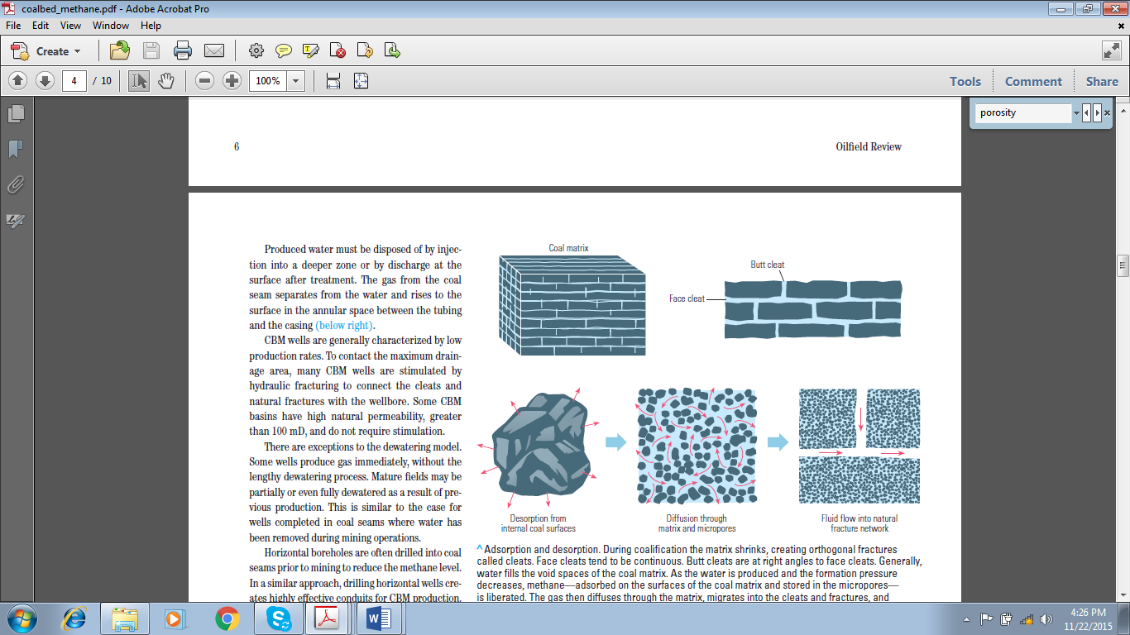
Adsorption and desorption. During coalification the matrix shrinks, creating orthogonal fractures called cleats.
Generally, water fills the void spaces of the coal matrix. As the water is produced and the formation pressure decreases, methane, adsorbed on the surfaces of the coal matrix and stored in the micropores, is liberated.
The gas then diffuses through the matrix, migrates into the cleats and fractures, and eventually reaches the wellbore.
Source: Jabouri et al, 2009

Slide 28
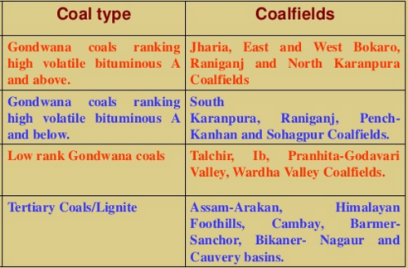
DISTRIBUTION OF COALFIELDS IN INDIA

Slide 29
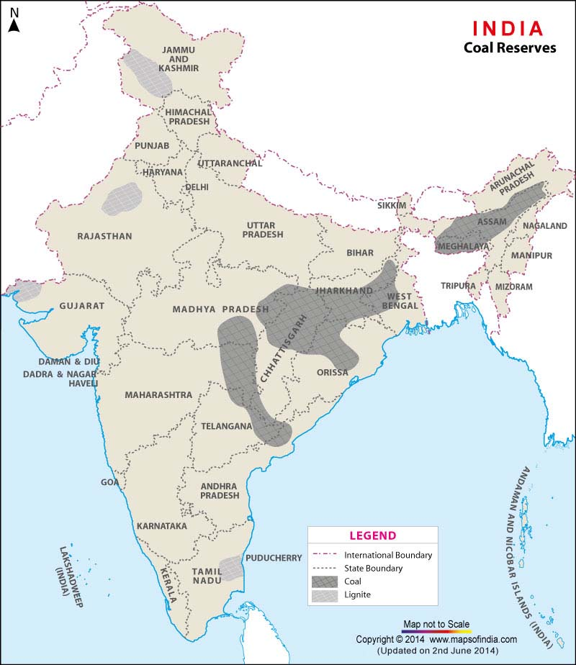
DISTRIBUTION OF COALFIELDS IN INDIA
Source : http://www.mapsofindia.com/maps/india/coalreserves.htm

Slide 30
Types of Indian coal
Coking
Prime – Prime Low volatile bituminous coals , Coke type G7 or better
Ro(mean) = 1.2. Upper Barakar seams in Jharia coalfield
Medium - Medium Low to high volatile bituminous coals, Coke type FG6,
Ro(mean) = 1.1-1.4. Lower Barakar & Raniganj seams in Jharia, Barakar seams in Raniganj, Bokaro, parts of Ramgarh, Karanpura, Sohagpur and Pench- Kanhan coalfields
Semi – High volatile, Coke type D-F,
Ro(mean) = 0.7.Lower Raniganj seams in Raniganj, Barakar seams in parts of
Ramgarh and Sonhat coalfields

Slide 31
Types of Indian coal
Non-coking
Superior – Superior High volatile bituminous B-C coals.
Mainly in Raniganj seams of Raniganj coalfield
Inferior – Inferior High volatile sub-bituminous coals. All coalfields
High Sulphur
Tertiary coalfields of Northeastern Region

Slide 32
Cumulative total of 301.56 Billion tonnes of Geological Resources of Coal have so far been estimated in the country as on 1.4.2014
Source: Ministry of mines
STATE | PROVED | INDICATED | INFERRED | TOTAL
Total | 125909 | 142506 | 33149 | 301564
West Bengal | 13403 | 13022 | 4893 | 31318
Jharkhand | 41377 | 32780 | 6559 | 80716
Bihar | 0 | 0 | 160 | 160
Madhya Pradesh | 10411 | 12382 | 2879 | 25673
Chhattisgarh | 16052 | 33253 | 3228 | 52533
Uttar Pradesh | 884 | 178 | 0 | 1062
Maharashtra | 5667 | 3186 | 2110 | 10964
Odisha | 27791 | 37873 | 9408 | 75073
Andhra Pradesh | 9729 | 9670 | 3068 | 22468
Assam | 465 | 47 | 3 | 515
Sikkim | 0 | 58 | 43 | 101
Arunachal Pradesh | 31 | 40 | 19 | 90
Meghalaya | 89 | 17 | 471 | 576
Nagaland | 9 | 0 | 307 | 315

Slide 33
Proximate Analysis
Moisture: Moisture is the water that exists in the coal at the site, time, and under the conditions it is sampled. Experts determine the amount of moisture in your samples by measuring the loss in mass between an as-mined sample and a sample that has been heated under controlled conditions to drive off the water that is not contained within the chemical structure of the coal.
Sulfur: It is important to measure the sulfur content in coal samples to evaluate the potential sulfur emissions from coal combustion, or for contract specifications purposes.
Volatile Matter: Volatile matter includes the components of coal, except for water, which are liberated at high temperature in the absence of oxygen. Volatile matter is a key health and safety concern as coals high in volatiles have an increased risk of spontaneous combustion. Scientists determine the volatile matter in coal sample by measuring the mass of volatiles before and after weight analysis under strictly controlled conditions.
Fixed Carbon: The fixed carbon content of coal is determined by subtracting the percentages of moisture, volatile matter and ash from the original mass of the coal sample: the solid combustible residue that remains after a coal has had the volatiles driven off.
ASH: Ash analysis tests are done

Slide 34
Significance of Various Parameters in Proximate Analysis
a) Fixed carbon→gives a rough estimate of heating value of coal
b) Volatile Matter:
Volatile matters is an index of the gaseous fuels present.
Typical range of volatile matter is 20 to 35%.
Volatile Matter proportionately increases flame length, helps in easier ignition of coal,
Sets of minimum limit on the furnace height and volume,
Influences secondary air requirement and distribution aspects, Influences secondary oil support

Slide 35
Significance of Various Parameters in Proximate Analysis
c) Ash Content:
Ash is an impurity that will not burn. Typical range is 5 to 40%.
Ash reduces handling and burning capacity,
increases handling costs, affects combustion efficiency and boiler efficiency, causes clinkering and slagging.
d) Moisture Content: Moisture in coal must be transported, handled and stored.
It decreases the heat content per kg of coal.
Typical range is 0.5 to 10%.
Moisture increases heat loss, due to evaporation and superheating of vapour, helps, to a limit, in binding fines. aids radiation heat transfer.
e) Sulphur Content: Typical range is 0.5 to 0.8% normally.
Sulphur affects clinkering and slagging tendencies,
Corrodes chimney and other equipment such as air heaters and economisers, limits exit flue gas temperature.

Slide 36
Ultimate Analysis
The ultimate analysis indicates the various elemental chemical constituents such as Carbon, Hydrogen, Oxygen, Sulphur, etc.

Slide 37
THANK YOU…..
bkprusty@mining.iitkgp.ernet.in

