Slide 1
SAARC Training Workshop Program, New Delhi
CBM Exploration, Exploitation And Its Uses
By
Prem Sawhney, CEO & Director
Deep Industries Limited

Slide 2
Acres to Diamonds
A prosperous farmer in Southern Africa wanted to be a diamond prospector, so he sold the farm and went searching for diamonds. After 2 years, finally out of money and having found no diamonds he drowned himself into the ocean
The new farm owner while walking along the stream after a hard day of working in the fields, retrieved an interesting rock. He placed the rock on his fire place mantel as show piece
Weeks passed, when a friend visited and enquired as to how the farmer got this rock. The new farmer informs that there are numerous similar rocks down by the creek. The friend then informs that the rock is a diamond
The farm overlaid one of South Africa’s largest diamond deposits
The first farmer, the would be diamond prospector failed to understand what he was looking for
CBM plays are somewhat analogous, in that the prospector must understand what he is looking for, and how to most effectively mine the resource

Slide 3
Indian Scenario-Rise in Natural Gas Demand
Growing demand for natural gas as a clean fuel specially in power & fertilizer Industry
Unconventional gas play like CBM & Shale gas is to play an important supplemental role in bridging the gap
* Source: DGH

Slide 4
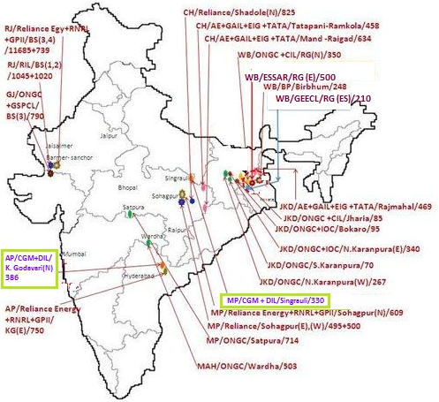
India CBM- Update
33 Blocks CBM & 62 TCF Resource potential
Main operators are Reliance Industries, Deep Industries, Essar, ONGC, Great Eastern, and others
CBM Blocks awarded till date
State | No. of Blocks | Area (Sq.Km)
West Bengal | 4 | 1308
Jharkhand | 7 | 2454
Madhya Pradesh | 7 | 3701
Rajasthan | 4 | 3972
Chattisgarh | 3 | 1917
Andhra Pradesh | 2 | 1136
Maharashtra | 1 | 503
Gujarat | 1 | 790
Orissa | 2 | 766
Tamil Nadu | 1 | 766
Assam | 1 | 113
Total | 33 | 17,246
* Source: DGH

Slide 5

Methane Generation & Storage
Expelled By-Product
Water
Methane
Carbon Dioxide
Organic Debris
Peat
Pressure
Residual Products
Coal
Methane
Heat
Time
Methane is associated with all coals
A tonne of coal can hold 4 to 20 cubic meters of CBM
Higher gas content of 30 to 40 cubic meters are also reported in the US coal basins

Slide 6
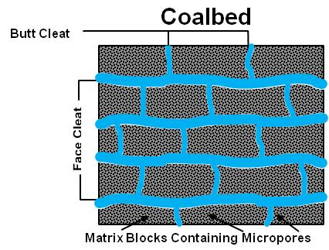
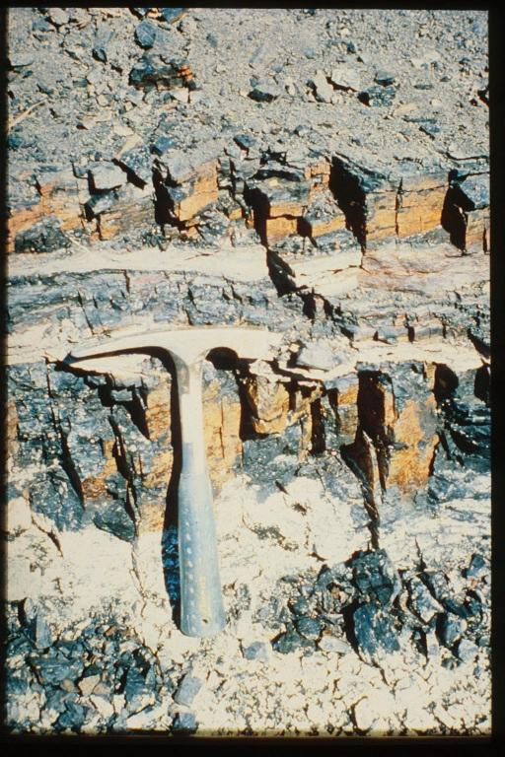
Uniqueness of Coal
Cleat System
  Permeability
  Stress Sensitive Permeability
  Matrix Shrinkage
Mechanical Properties
  No Tensile Strength, Loss of Shear Strength
  High Stress, Low Young’s Modulus
  Hydraulic Fracture Complexity
Gas Stored by Adsorption
  Adsorption Isotherm, Sorption Time
  Gas Content, Under-Saturation
  Fick’s Law
Operations
  Low BHFP, Start-up Procedures, etc
  Fines Migration
PERMEABILITY AND CLEAT-APERTURE
Notes:
Read the slide bullets as they come up
In the next several slides we will have a very brief introduction to these subjects.

Slide 7
Structured Resource Evaluation
Core Program
Core & Log
Gas Content, Adsorption Isotherm
Sorption Time, Saturation
Will adjacent intervals impact production
Perm Test Program
Injection / Falloff Permeability Test
Absolute Permeability
Stress Sensitive Permeability
Indication of Perm Anisotropy
Completion Effectiveness
Production Test (5-Spot Pilot)
Interference & Production Test
Completion Effectiveness
Permeability Anisotropy & Orientation
Relative Permeability
Reservoir Simulation
Spacing & Pattern
Field / Area Production Potential
Field / Area Development Program
Core / Perm Well
Core / Perm Well
Five Spot
Core / Perm Well
Five Spot step out
Core / Perm Well
Core / Perm Well
Core / Perm Well
Core / Perm Well
Core / Perm Well
Five Spot
Core / Perm Well
Core / Perm Well
Core / Perm Well
Core / Perm Well
Core / Perm Well
Core / Perm Well

Slide 8
Some What Different Than Conventional Gas
Coalbed Methane
Natural Gas
Production
Production
Gas
Gas
Water
Water
Time
Time
Source : Coal Shale
Reservoir : Coal Sand
Storage : Adsorption Free state in pores
Production : Desorption, Diffusion Free Darcy flow
& Darcy flow
Generally 10 CBM wells produce what one natural gas well would be capable of

Slide 9
DIL’S CBM EXPERIENCE

Slide 10
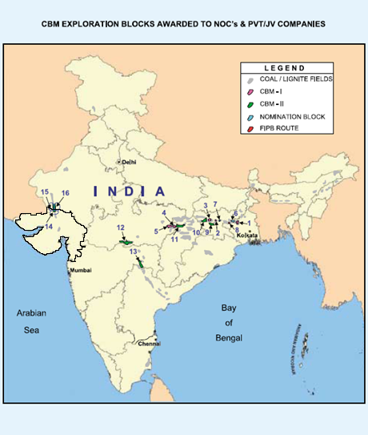
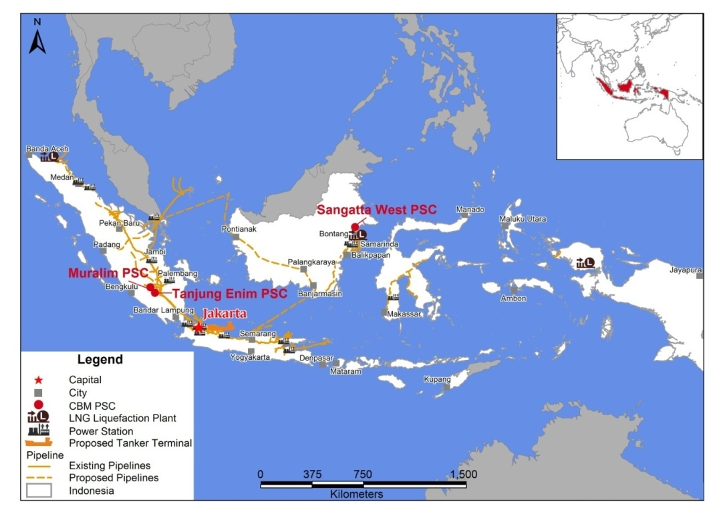
DIL’s CBM Blocks
India
Indonesia
Block Name | (Area Sq. Km)
Melak Mendung III CBM Block | 995.70
Block Name | (Area Sq. Km)
Singrauli Block | 330
Block Name | (Area Sq. Km)
GV North Block | 386

Slide 11
DIL CBM Blocks
Block Name | SR-CBM-2005/III | GV(N)-CBM-2005/III | GMB Melak Mendung 3 (in consortium with MIEL)
Country | India | India | Indonesia
Block Area (Sq.Kms) | 330 | 386 | 995.7
Effective Area (Sq Kms) | 105 | 150 | 260
Depth Range | 600 – 900 M | 700 – 1200 M | 500-1000 M
Avg. Coal Thickness | 25 m | ~ 17 m | 15 m
Gas Content | ~ 4 m3/t | ~ 4 m3/t | Avg.~ 7 m3/t
Permeability | 5 – 10 md | ~ 5 md | ~ 7md
CBM Resource of block | 18.92 BCM | 29.70BCM | 45.31 BCM

Slide 12
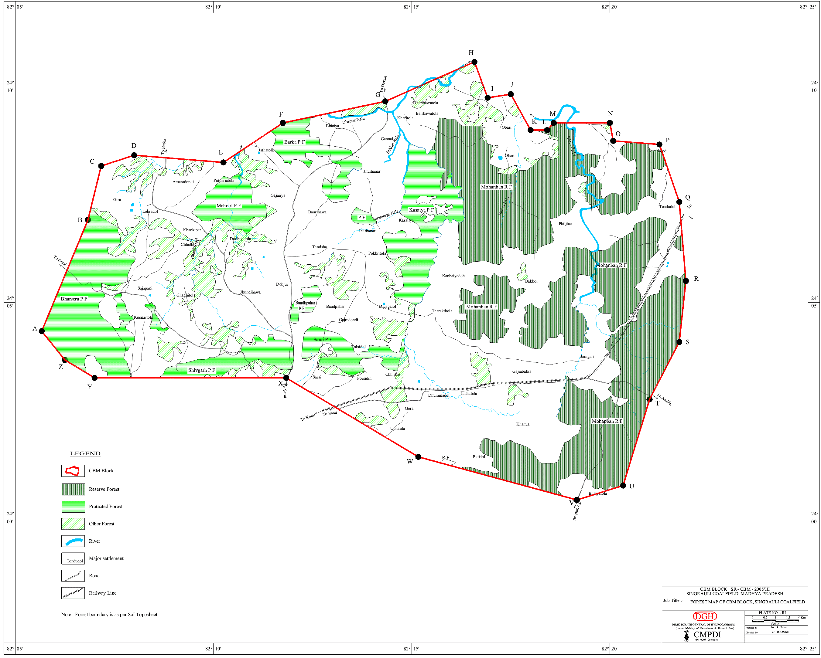
Singrauli CBM Block - At a Glance
Parameter | Singrauli CBM
Block Stage | Ready to enter Production phase
Acreage | 330 sq. km
Reserves / Resources | 1,106 bcf (GIIP)
No. of Seams | 8
Coal Seam Depth | 2015 ft – 2800 ft
Coal Seam Thickness (net) | B1: 58.4 ft, B2: 87.49 ft
Gas Content | 130 – 150 (scf/ton)
Operator | DIL
Participating Interest | Coal Gas Mart (10%), DIL (90%)
Offtake | To be Marketed
Evacuation | Cascades/Pipeline to nearby industrial towns

Slide 13
CBM Challenges
Exploration- Challenges
Establish Coal Thickness & Continuity
Accurately measure Gas content & Saturation
Get fix on Permeability Variations
Establish CBM Well Producibility
Get CBM Reserves Certification for Bankability
Field Development-Challenges
    Land Acquisition
    CBM Well Drilling
    CBM Well Completion
    CBM Well Spacing
    Surface facilities & Production Operations
    Produced water Handling
    Gas Evacuation & Marketing
    Social, Environmental, Logistical & Regulatory

Slide 14
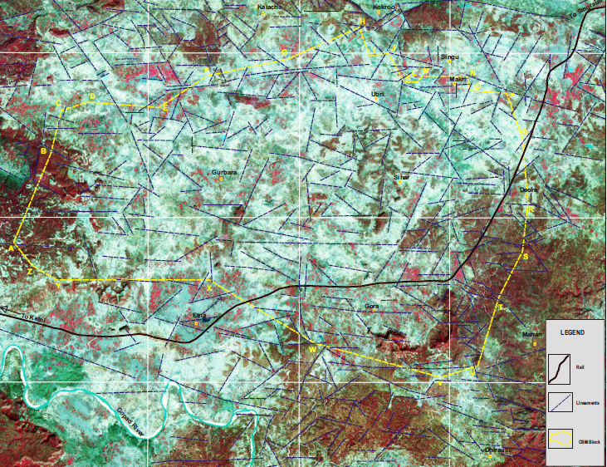
Singrauli CBM Lineament Map

Slide 15
Singrauli Prospect Evaluation
Core Program
Core & Log
Gas Content, Adsorption Isotherm
Sorption Time, Saturation
Will adjacent intervals impact production
Perm Test Program
Injection / Falloff Permeability Test
Absolute Permeability
Stress Sensitive Permeability
Indication of Perm Anisotropy
Completion Effectiveness
Production Test (5-Spot Pilot)
Interference & Production Test
Completion Effectiveness
Permeability Anisotropy & Orientation
Relative Permeability
Reservoir Simulation
Spacing & Pattern
Field / Area Production Potential
Field / Area Development Program
SC-06
SC-05
SC-03
Five Spot
SC-08
SC-04
SC-07
SC-01
SC-02
EXPLORATION Fixing CBM Gas-in-place and identification of CBM fairway by core hole drilling OBJECTIVES Fixing well producibility from 5-spot cluster wells further refined by commercial pilots

Slide 16
Geology of the Block

Slide 17
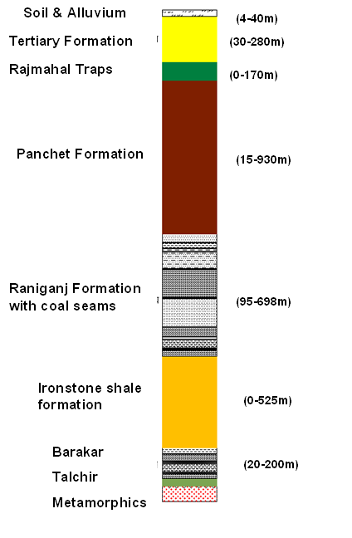
GEOLOGY OF THE BLOCK
The Barakars grade conformably into Iron Stone Shales also called Barren Measures
The overlain Raniganj formation progressively grades into a thick sequence of strata of Panchet formation.
Coarse, pebbly, ferruginous quartz arenite with subordinate amount of clays rest unconformably lay over Panchet formation, referred to as Supra Panchets and Tertiary Sediments
Barren measure

Slide 18
Type Well Completion Intervals and Reservoir Simulation Single Well Model Layout for Areas B1 & B2
Coal Thickness Summary
B1
B2

Slide 19
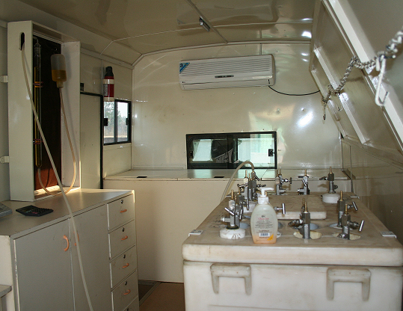
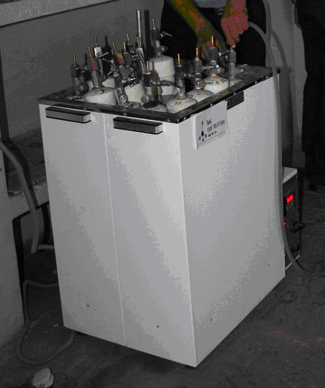
Gas Content Measurements
Major precautions taken are:
  To minimize the lost gas time.
  To record accurate desorbed gas volume and weight of coal samples.
  Correction of head-space volume
  To ensure zero leakage of gas during the entire period of desorption.
  Maintain Reservoir temperature
  To determine the residual gas through an industry standard procedure.
Notes:
19

Slide 20
In Situ Gas Content
Gas Content
The methane saturation of Seam VII, core hole SC-04 was utilized for all four seams in both Areas B1 and B2.

Slide 21
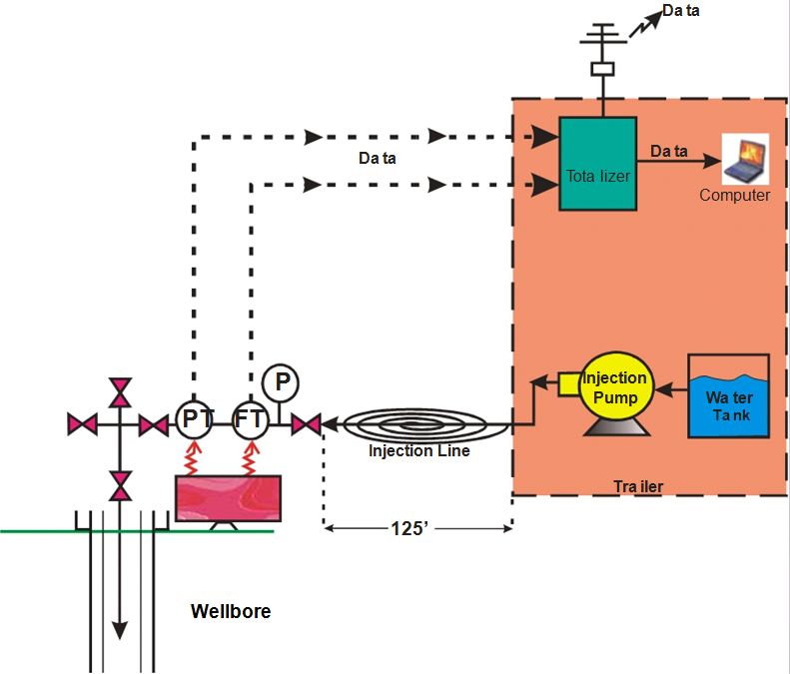
Permeability – Injection/ Fall off Testing
Test interval should be isolated.
Breakdown Treatments may be required to establish communication with the Well prior to Pre-stimulation Testing.
Injection/falloff Test (where water is injected) usually result in correct bulk permeability estimates
Injection Tests should be designed such that the Maximum Bottom Hole Treatment Pressure is below Fracture Pressure.

Slide 22
Permeability Enhancement/ Production
Low Stress,
Naturally Fractured
(10 md)
Low Stress,
Moderately
Fractured
(2 md)
High Stress,
Poorly
Fractured
(0.5 md)
3.0
2.5
2.0
1.5
Gas Production, MMcfd
1.0
0.5
0.0
1
2
3
4
5
6
7
8
9
10
Time, Years
Source: Sanjuan basin, 100+ well sample

Slide 23
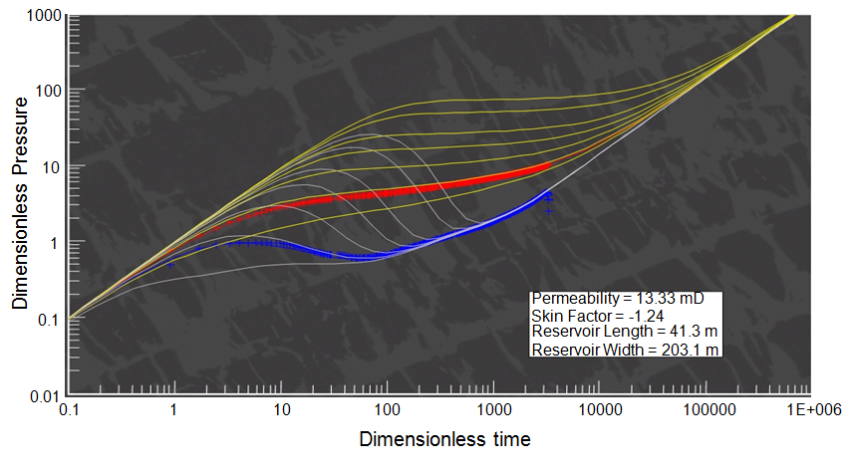
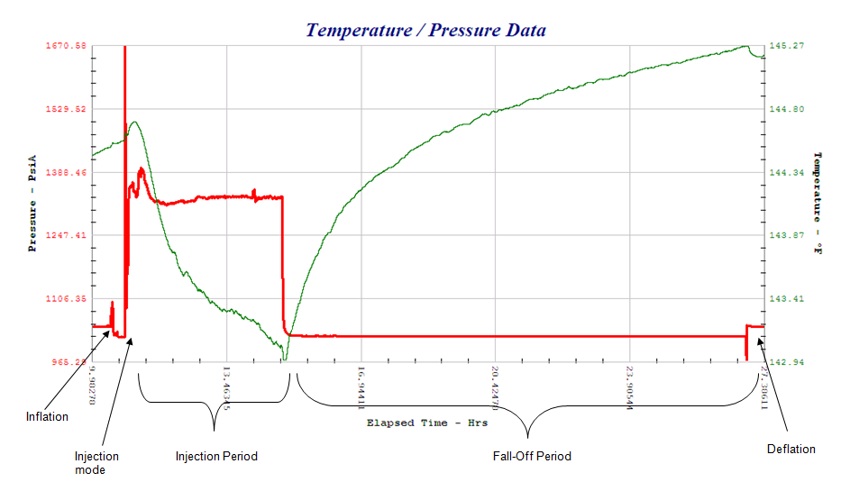
Permeability- Injection Fall-off Testing
Singrauli CBM Block
As per MWP, 16 injection/ fall of test in 8 coreholes need to be carried out for permeability determination.
14 Injection Fall off tests carried out during Phase-I
2 Tests could not be carries out on SC#1 corehole due to non-occurrence of coal seams in the well.
Permeability value of the coal seams calculated from the tests in the range of 0.38 to 13.40 md

Slide 24
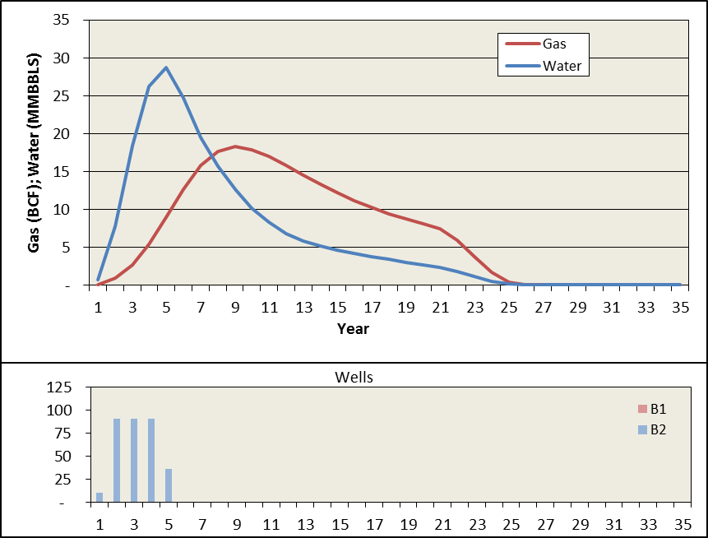
Production Forecast and Drilling Schedule for Singrauli CBM Block Development
Production Forecast & Drilling Schedule for Development

Slide 25
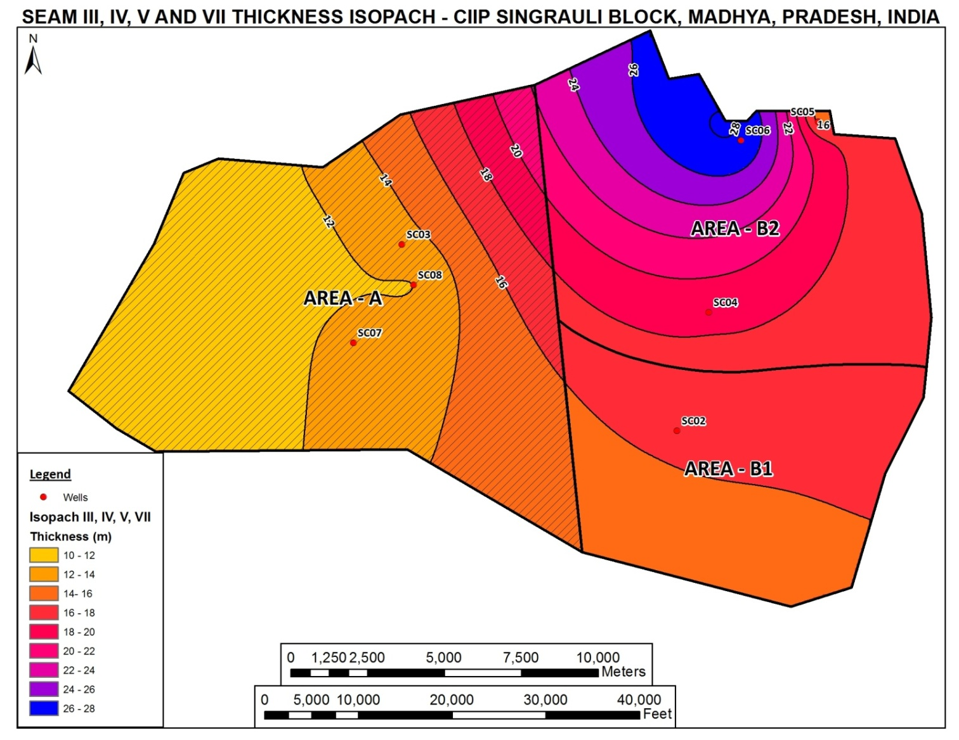
Findings of Singrauli CBM Block
Five Spot
Findings - Area B2
Block Area | 330 Sq. Kms
Fairway Area | 102 Sq. Kms
Depth Range | 600 – 900 M
Avg. Coal Thickness | 25 m
Gas Content | ~ 4 m3/t
Permeability | 5 – 10 md
Methane Saturation | 80 – 90 %
CBM Resource of block | 18.92 BCM
Development Scenario | 316 Wells
Well spacing | 80 Acres
Production Potential | 1.0 MMcmd
Area B2 – Most Prospective
Area B1 – Moderately Prospective
Area A – Poorly Prospective

Slide 26
Drilling, Stimulation & Production
Drilling, Stimulation & Production
Notes:
26

Slide 27
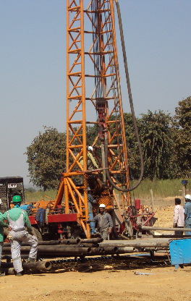
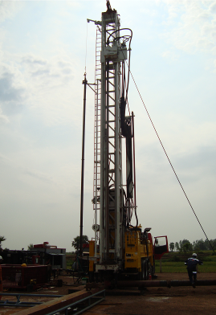
Drilling
Drilling large number of wells at low cost is a big challenge in CBM.
12 1/4” hole X 9 5/8” casing
Drilling up to surface casing using water well rigs
Coal section to the target depth drilled using
Air Drilling rigs
This innovative combination drilling results in
cost reduction up to 30% per well basis.
Mud Drilling
300-400 M (Approx)
8 ½” hole X 51/2” casing
Air Drilling
Water Well Drilling Rig
950 M (Approx)
Air as drilling yielded benefits in terms of :
Minimum formation damage
Faster penetration rates, Longer bit life
and fewer trips
Open Cleats Around Wellbore
Damage
Zone Around Wellbore
Air Drilling and Water Well Rig combination
reduces drilling Costs
Air Drilling Rig
Air Drilled Well
Mud Drilled Well

Slide 28
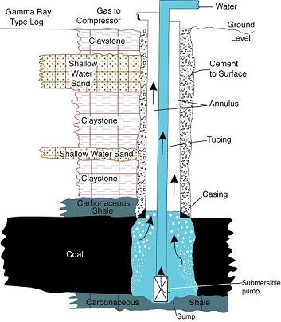
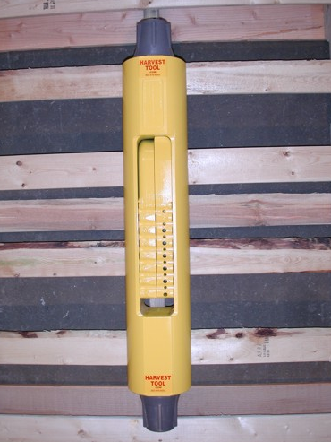
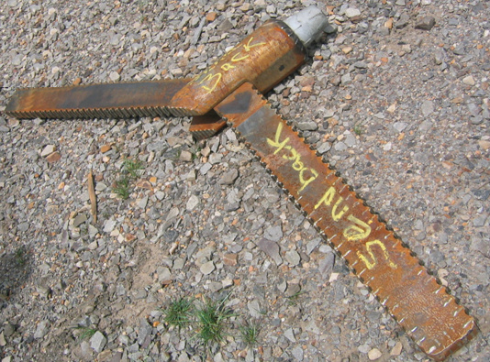
Open Hole Completion
Open Hole Completion
Open hole completion with hole enlargement of the last coal seam using under-reamers implemented in all 5 test wells
ESP lowered for dewatering of wells
Subsequently, Progressive Cavity Pumps (PCP) installed in all 5 wells
Under Reaming Tool

Slide 29
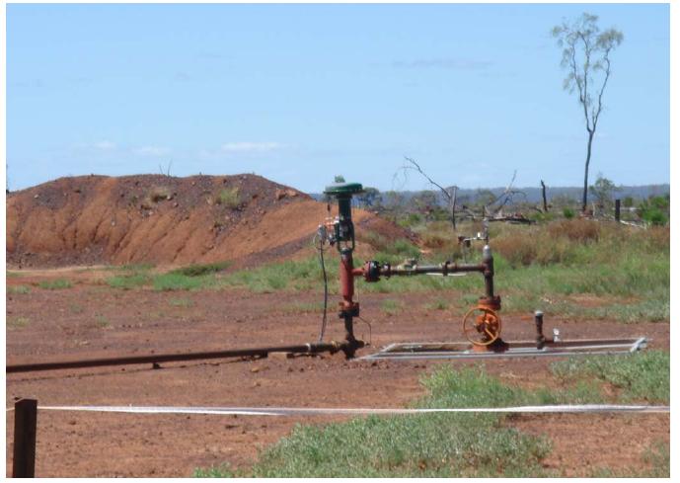
Dewatering and producing the CBM Wells
CBM Well Production Challenges
  Produced water treatment and disposal
  Sand flow back
  Coal fines generation
Produced Water Quality
  Elsewhere CBM Projects are not so lucky as water quality is not so good & requires treatment and in-situ disposal.
PC Pumps operated at right speeds to achieve optimum dewatering
Dedicated Work Over Rig (s) required at all times for Pump repairs during initial periods.
1
0.8
k_{rw}
k_{rg}
0.6
0.4
0.2
0
0
0.2
0.4
0.6
0.8

Slide 30
FIELD DEVELOPMENT

Slide 31
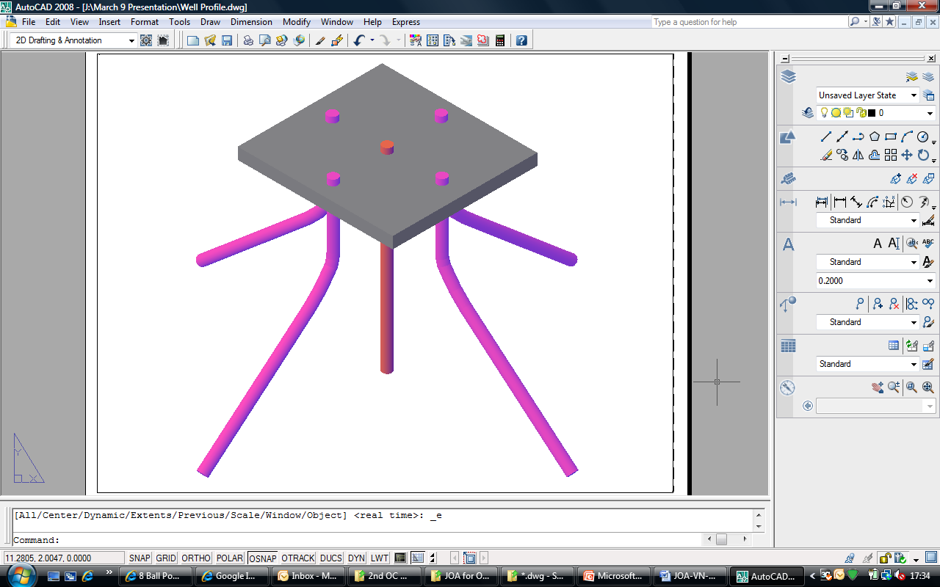
Land Management- A big challenge
Directional Wells from a Pad
  One vertical well and four deviated wells at 90 Deg phasing.
  Horizontal reach is between 300 m to 600 m (40 – 80 acres spacing).
  Drilling costs increase marginally but provide many benefits
    Land Requirement reduction up to 70%
    Land cost savings and Civil work savings
    Savings on ILMs of drilling rigs, logging trucks, cementing units, HF Units
    Savings on pipelines, instrumentation and surface facilities
    Security
    Logistics etc.
500 m

Slide 32
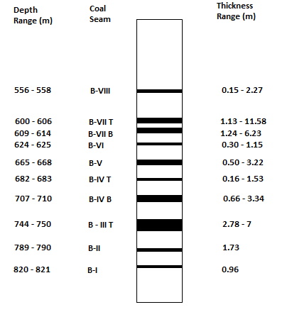
Multiple Seam Completion- A Big Challenge

Slide 33
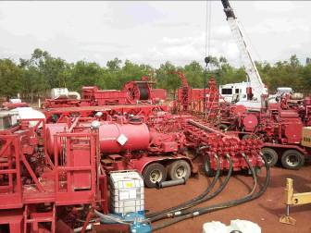
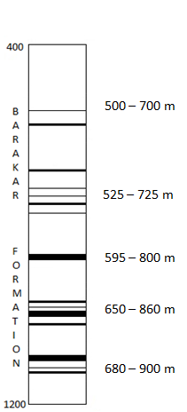
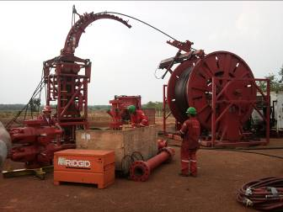
Hydro Fracturing
Coiled Tubing unit is used to carry out perforations using sand jetting technique
As coals have low to moderate permeability (few milidarcys), some type of formation, stimulation is required in order to obtain commercial gas production from a coal seam
The objective of hydro fracturing is to create a wide vertical fracture of greater length to create a conduit that connects the complex cleat system to the well bore.
Using CTU equipment reduces the operational constraints, cost and time.
Coil tubing Unit

Slide 34
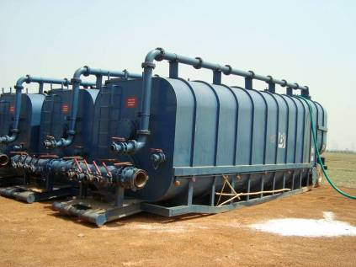
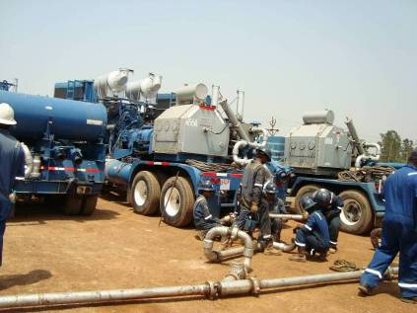
Hydro Fracturing
USING CTU TECHNOLOGY
Frac Unit
Frac Tanks
Frac Unit
CONVENTIONAL FRAC UNIT
Coiled Tubing Unit
34
Notes:
34

Slide 35
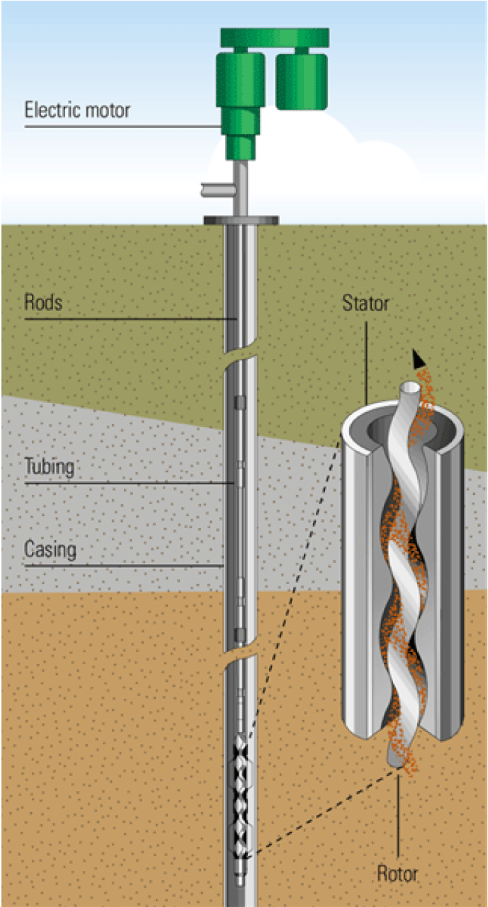
Production Facilities Designing
Once optimum well spacing & completion design have been selected production & operational facilities need to be designed. Individual well site setup will consist of the following:
Prime Mover Source
Electric Motor for running the down hole pump
Variable Speed Drive for motor control
Separators for Gas & Water
Valves, pressure sensors/regulators & instrumentation
Meters for gas and water measurement
Safety relief valves and bypass gas line

Slide 36
Water Management - Treatment and Disposal Challenge
Produced water can be utilized near CBM well sites depending on the water quality
  Agricultural Use : Irrigation, Livestock watering
  Surface Discharge : Discharged into nearby River, Streams, etc.
  Use for Drilling & HF : Produced water can be stored in the water pits at site and can be directly used for carrying out drilling and Hydro-fracturing jobs in the wells.
  Public Water Use : Domestic use, Municipal water supply (potable use and non-potable use)
  Industrial Use : Dust control, Power Generation
  Injection : Underground Injection
  Impoundments : Wildlife watering, Fisheries/fish ponds, Recharge, & Infiltration Evaporation ponds

Slide 37
Field Automation
Each CBM well, GGS, Satellite and Main Compressor Stations, Metering System and Power Generation are automated through SCADA.

Slide 38
Social, Environmental & Logistical Challenges
Social: Local population dynamics
  Effective CSR Programs
Environmental: As such CBM operations are easy on environment
  CBM reservoirs are normal to sub-hydrostatic & call for low pressure operations
  Existing regulations need relook
Logistical: Generally all CBM operations occur in the frontier areas
  CBM requires drilling of very large number of wells and setting up required surface facilities
  Extensive logistics needed due to zero or very low infrastructure

Slide 39
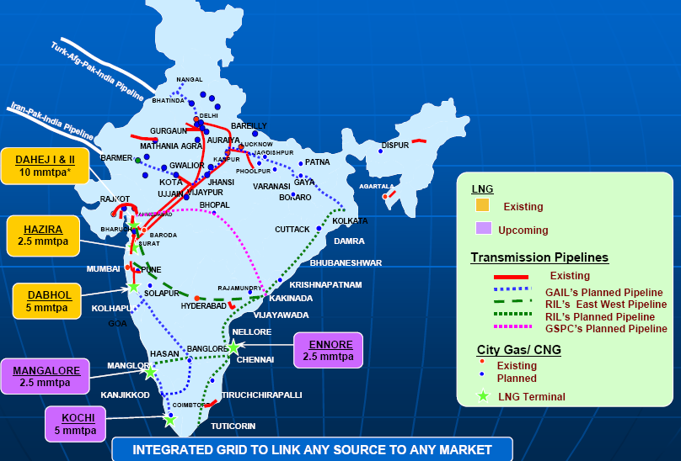
CBM Exploitation : CBM Evacuation Challenges
Almost all the CBM blocks in India are located in frontier areas
No CBM gas transportation infrastructure developed

Slide 40
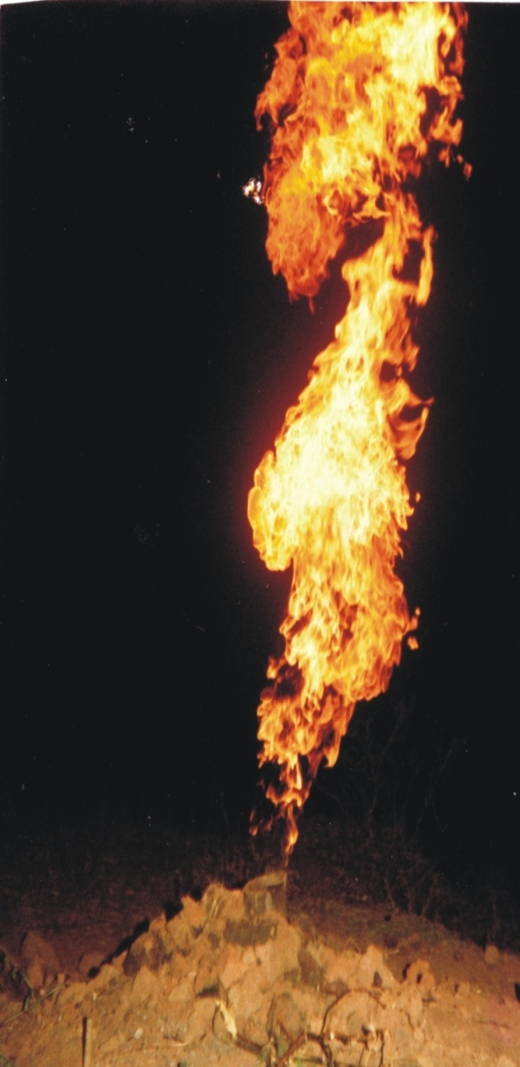
Conclusions
Coalbed methane is a technology play that requires reservoir understanding and appropriate technology for all phases of prospect evaluation and field development.
Drilling, completing and producing of large no. of wells at low cost using innovative techniques always remains a challenge.
CBM Reservoirs are generally water saturated & require dewatering and gas production takes time to commence.
CBM, therefore is a game of patience and perseverance
Notes:
40
40

Slide 41
THANK YOU

