Slide 1
Energy Based Livelihood Contributing to Economic Empowerment of Marginalized Sectors and Women in Nepal
Presented By
Laxmi Narayan Uprety
Under Secretary
Ministry of Women, Children and Social Welfare
Government of Nepal
Male, Maldives

Slide 2
Outline of Presentation
Regional Perspective
Context: Energy, Poverty and Gender
Renewable Energy related Polices
Renewable Energy Related Ministry, Institution and programme
Challenges
Way Forward

Slide 3
Regional Perspective
80 Percent of the women within SAARC region belong to the rural areas.
For their domestic as well as informal commercial use, women within the SAARC depend on various energy sources some of which are unsustainable and unhealthy but are crucial for making living.
Energy sources in rural settings are:
  low quality biomass derived from animal dung and crop residues
  wood chips
  Fuel wood etc.
Over dependence on these energy sources because of “ no-cost “ factor.
Less efforts and attention in the improvements to energy based informal sector livelihoods within the region
Acquisition, and use of these energy sources has negatively affected health and life style of women.

Slide 4
Regional Perspective(Contd..)
Most of the population ,especially don’t have access to clean energy sources.
Imbalanced distribution of modern energy sources between the rural and urban area
Inadequate integration of gender perspective in the energy sector
Inadequate access to energy to marginalized sectors/communities
Women and the marginalized have become economically vulnerable due to their dependence on unreliable and unclean energy sources of energy for livelihood.
Strong nexus between women, energy and poverty
20-30 percent of women’s income in Asia comes from informal sector activities which are marked with traditional skills and sources of energy.

Slide 5
Nepalese Context
Total Population: 26,494,504 (census, 2011)
Out of total population 81.80 % are Rural population
95.5% of poor people live in rural areas
Traditional biomass resources-87.1%,
Commercial energy resources-12.26%,
Renewable energy resources-0.70%

Slide 6
Nepalese Context (Contd..)
Out of total poor people, significant number is that of female poor
Gender discrimination exists in the society and it contributes in making poverty further aggravated.
Social inclusion is an emerging agenda, but yet to be fully materialized
Poor accessibility causes more poverty.
Issue of energy and women are directly linked.

Slide 7
Renewable Energy related Policies and Programme in Nepal
It is to be noted that all these policies have focused on ensuring accessibility of energy sources to poor people giving emphasis on women.
Renewable (Rural) Energy Policy, 2006
(It aims to contribute to rural poverty reduction and environmental conservation by ensuring access to clean, reliable and appropriate energy in the rural areas)
Subsidy Policy for Renewable Energy, 2013
(It aims to provide opportunity to low-income rural households to use rural energy technology and attract private sector entrepreneurs. The strength of the policy lies in its strong recognition of the need to enhance access and affordability of women and the socially excluded groups.)
Rural Energy Subsidy Delivery Mechanism ,2013
(recognizes the governance structure for the disbursement: representation of GESI Unit in the internal technical review committee as well in the local bodies formed such as user committees, Economic Development Committee. This policy also has specific categorization criteria for identifying the poor, the ethnic groups as well as the aged.)
13th Plan (2013-2016) of the country also highly emphasized on the need of development and utilization of different forms of energy including solar and wind energy. It has also emphasized on the renewable energy. It has also stressed on the need to include women’s need in all sorts of intervention that are meant for exploring and developing different sorts of energy.

Slide 8
Renewable Energy undertaking Ministry and Institution
Ministry of Science, Technology and Environment (MoSTE)
  The vision of the MoSTE is to establish science, technology and environment as key pillars for achieving sustainable and broad based economic growth contributing to employment generation and poverty reduction

Slide 9
Alternative Energy Promotion Center (AEPC)
  AEPC is a Government institution established on November 3, 1996 under the then Ministry of Science and Technology ( now, Ministry of Science, Technology and Environment) with the aim to:
  popularize and promote the use of alternative/renewable energy technology.
  raise the living standard of the rural people.
  protect the environment.
  develop the commercially viable alternative energy industries in the country

Slide 10
AEPC's Programme
AEPC's some programmes implemented with the aim to promote renewable energy to improve livelihoods of rural communities:
Biogas Support Programme
Energy Sector Assistance Programme (ESAP) Phase I and Phase II
Improved Water Mills
RERL
REP
National Rural Renewable Energy Programme
In different interventions of institutions mentioned, gender issue is well taken. There is a realization that until and unless women’s energy need is not fulfilled women empowerment and upliftment is not possible.

Slide 11
Renewable Technology in Nepal
Solar Energy Technology ( e.g, Solar dryers)
Biomass Energy Technology ( e.g, ICS, Rocket Chullo)
Wind Engergy Technology
Biogas Energy Technology ( eg, community biogas plan)
Mini/micro hydro Technology (
Improved water mills ( IWM electrification
Biofuel ( Jatropha biofuel)

Slide 12
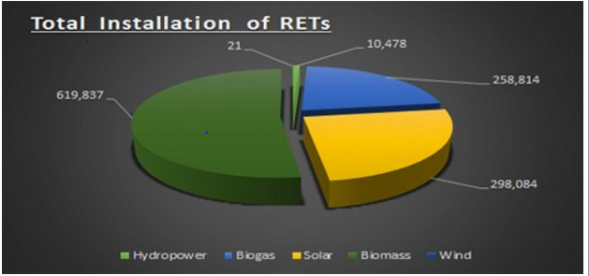
Total Renewable Energy Technologies installed (data 2011)

Slide 13
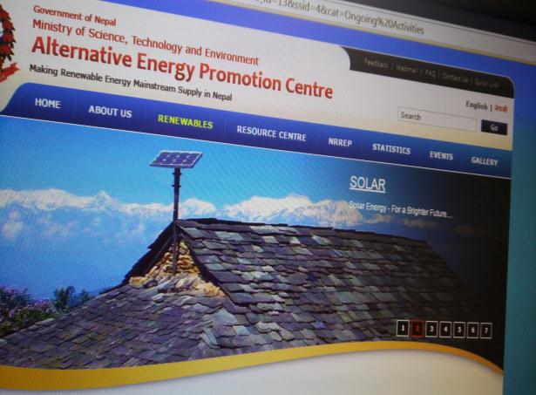
Different Forms of Alternative Energy in Nepal
Solar..

Slide 14
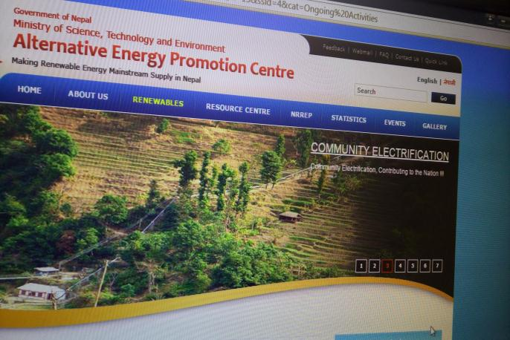
Different Forms of Alternative Energy in Nepal
Community Electricity

Slide 15
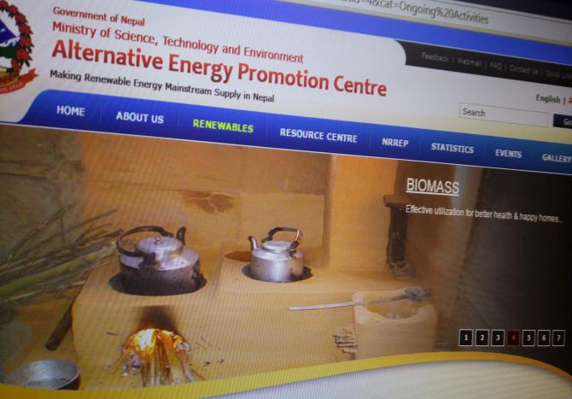
Different Forms of Alternative Energy Energy in Nepal
Improved Cooking Stoves

Slide 16
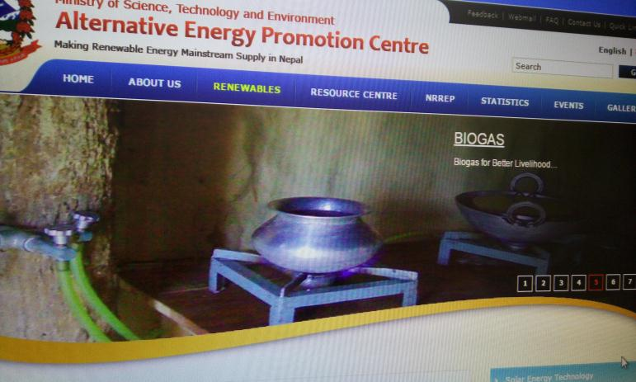
Different Forms of Alternative Energy Energy in Nepal
Biogas

Slide 17
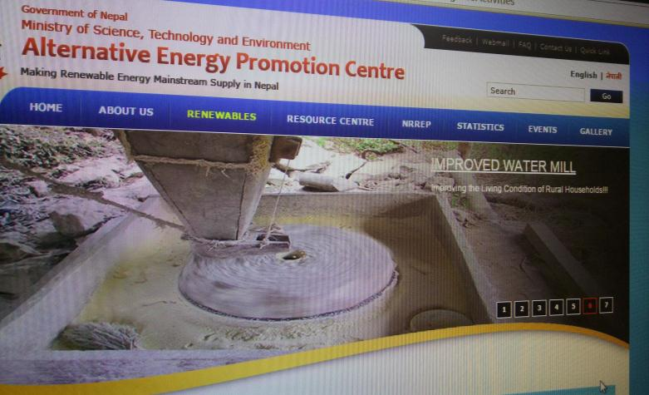
Different Forms of Alternative Energy in Nepal
Improved Water Mill

Slide 18
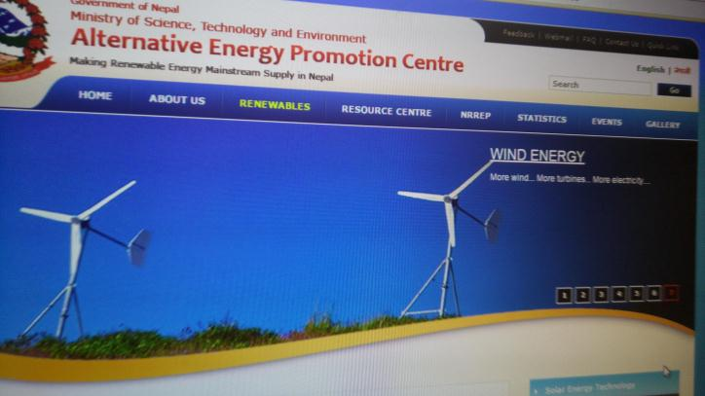
Different Forms of Alternative Energy in Nepal
Wind Energy

Slide 19
Challenges
Diverse geography/ difficult landscape
Weak service delivery
Under-representation and inadequate participation
Gaps in awareness, knowledge and capacity
Gender issue is yet to be incorporated fully
Women work burden increases because of difficulty in managing cooking energy resources(especially firewood)
Energy need in rural areas is still fulfilled through conventional energy sources, which are not clean.

Slide 20
Way Forward
Linkages of livelihood development program with energy development and promotion program
Gender issue should be interlinked with any intervention that is meant at developing and promoting different forms of energy
Make efforts to make conventional energy sources less polluting and cleaner
Energy development program at rural areas should be focused on the need to marginalized and women
Run different programs which ensure empowerment of women through easy accessibility of energy sources to rural women
Access to efficient and affordable energy sources ( clean energy) to women to provide opportunities for their economic and social development
  Positive impact on small scale production operations
Commitment to “ sustainable energy for all” initiatives

Slide 21
Conclusion
Relationship between the types of energy and the livelihood activities of women and their economic positions is direct
It implies empowerment of women in terms of accessibility of energy sources.
However, energy needs to be clean
Innovation may turn conventional energy sources into modern one.
Greater prospect of renewable and bio-energy
Involvement of women in decision making not only in reproductive decisions but also in energy use.
Concerted efforts are needed to improve the lives of rural communities with major involvement of rural women by empowering them through awareness raising, skill building and instilling good practices in energy use and consumption.
Moreover, there should be provisions to provide loans to set up energy efficiency cooking stoves from those who want to start their enterprises.
Energy is lifeline of human being; It should be promoted especially uplifting the lives of women.

Slide 22
Thanks for Your attentiveness

