Slide 1
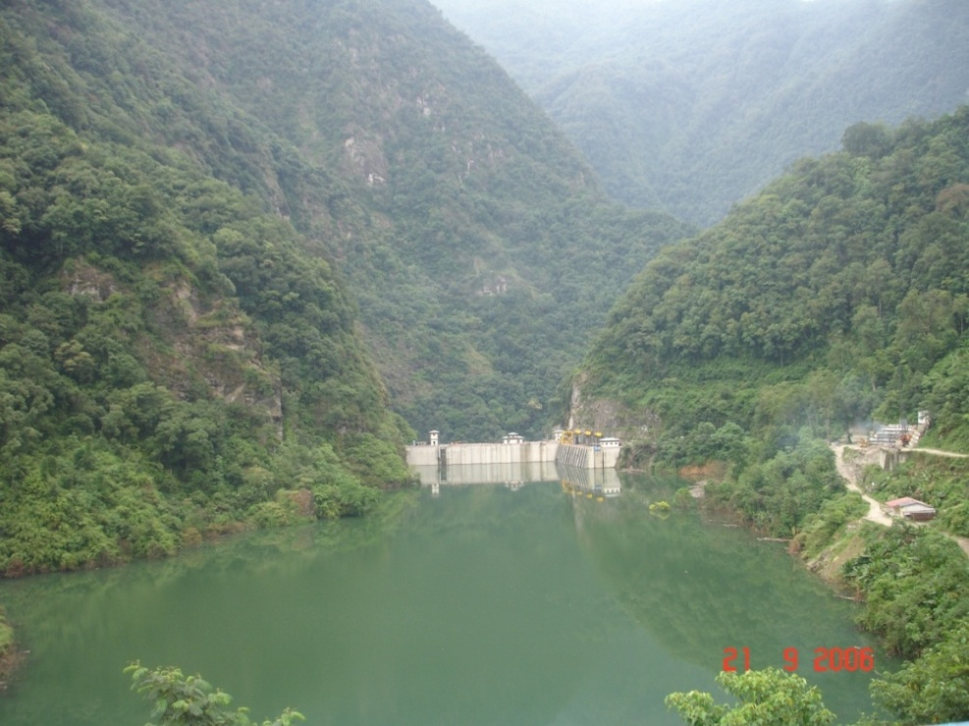


Energy Based Livelihoods Contributing to Economic Empowerment of Marginalized Sectors and Women
Department of Renewable Energy
Ministry of Economic Affairs
Bhutan
01-02 December 2015
Notes:
1

Slide 2
Outlines
Country Information
Background on power sector reforms
Energy in Bhutan
Initiatives taken by the Government to improve the livelihoods marginalized sections
Benefits of the Energy Projects
Challenges
Way Forward

Slide 3
Country Information
Area – 38,394 sq. km
Population (2015 est.) – 768,000
  Forest Cover (2014) – 70.5%
  Literacy rate (2012) – 63%
  GDP growth (2014) – 5.46%
  Population Poverty rate (2012) – 12%
  Annual Electricity Generation (2014) – 7,147.095 MU
  Electricity Exports (2014) – 72.5%
  Electricity Consumption (2014 per capita) – 2,600 kWh
  Electricity Contribution to Revenues (2014) – 20%
  Electricity Contribution to GDP (2014) – 14.15% Rural Electrification Achievement as of September 2015- 95.35%

Slide 4
  Power Sector Reforms-Background
Electricity Act passed by the 79th Session of the NA on 26th July 2001
Unbundling of Power Sector in 2002
DGPC (Established in Jan 2008) – O&M of all existing hydropower plants owned by RGoB and the construction of HEPs
BPC – responsible for Transmission & Distribution
BEA, responsible for Regulation, became fully autonomous in January 2010
DOE – National Policy & Planning matters

Slide 5
Restructuring of Department of Energy
DOE was further upgraded into 3 new Departments in December 2011 as:
Department of Renewable Energy- Responsible for overall renewable energy planning and implementation.
Department of Hydromet Services - For the management and provision of hydrological and meteorological data.
Department of Hydropower and Power Systems - For hydropower & Power system planning, designing, development and implementation.

Slide 6
Energy in Bhutan
Fuel wood is main source of primary fuel
Electricity is 99% Hydropower
  Large Hydropower potential – 30,000 MW
  Techno-economically viable – 23,500 MW
  Total installed capacity – 1,606 MW (~ 5.35% of potential)
  Hydropower under construction – 3,658MW (~ 12.2%)
  Existing Transmission lines (66kV & above) - 1,015.3 km
  Peak load demand (2014) – 333.41MW

Slide 7
Initiatives taken by the Government to improve the livelihoods of marginalized sections
Electricity for All initiative
Free 100 units of energy for the rural households
Distribution of the subsidized improved cook stoves (13,500)
Distribution of subsidized improved heating stove (1600)
Distribution of subsidized solar home lighting system as a off-grid electrification (Approx. 3000)
Distribution of subsidized biogas stoves (2600)
Involvement of the school dropouts (both men and women) in the O&M of the off-grid and grid systems
Involvement of rural women and NGOs in the energy activities

Slide 8
Benefits of the Energy Projects
Enhanced energy security and diversification
Reduced GHG emission on a global scale through promotion of RE
Improved Health and sanitation of the rural inhabitants
Improved fuel wood efficiency
Increased time for the housewives for their family and other household chores.
Empowerment of women and gender equity, and
Improved income generation for the rural people

Slide 9
Challenges
Difficult geographic terrains
High cost of RE technologies
Lack of adequate financial resources
Limited technical expertise
Lack of time for rural women to participate in energy related trainings and activities
Limited market size or critical mass
Diffused/intermittent RE resources vis-à-vis large hydro

Slide 10
Way Forward
Need for proper RE policies and regulations
Smart subsidies and appropriate government interventions,
Holistic energy development plans in harmony with social, technical and environmental considerations,
Change of mind set and political will
Conceiving of development process are based on consultation with the actual beneficiaries
Enhancing the productivity of the marginalized sections of the society

Slide 11
  Thank You
11

