Slide 1
WELCOME MEMBERS
SOUTH ASIAN ASSOCIATION FOR REGIONAL COOPERATION (SAARC)

Slide 2
Underground mining
A K Rana
General Manager,
Underground Mining Division,
Central Mine Planning & Design Institute Ltd.

Slide 3
WORLD ENERGY SCENARIO

Slide 4
COAL CONSUMPTION SCENERIO
Energy Consumption (MT Oil equivalent)
Year | 2010 | 2011 | 2012 | 2013 | 2014
World | 3611.2 | 3777.4 | 3798.8 | 3867.0 | 3881.8
India | 260.2 | 270.1 | 302.3 | 324.3 | 360.2
Pakistan | 4.9 | 4.4 | 4.4 | 3.5 | 4.9
Bangladesh | 0.8 | 0.7 | 0.9 | 1.0 | 1.0

Slide 5
INDIAN COAL RESOURCES
Billion Tonnes
Depth Range (m) | Proved | Indicated | Inferred | Total
0-300 | 100.6 | 68.7 | 9.6 | 178.9
300-600 | 14.9 | 59.9 | 15.9 | 90.7
0-600* | 13.8 | 0.5 | 0 | 14.3
600-1200 | 2.3 | 14.2 | 6.2 | 22.7
Total | 131.6 | 143.2 | 31.7 | 306.6
* For Jharia coalfield only

Slide 6
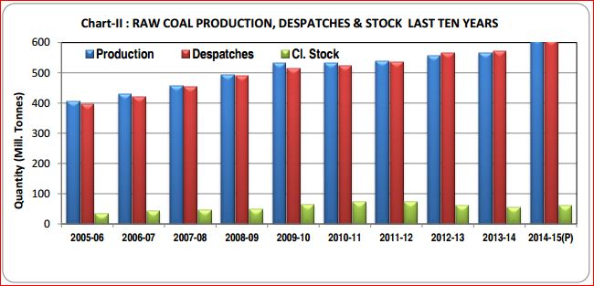
COAL PRODUCTION IN INDIA

Slide 7
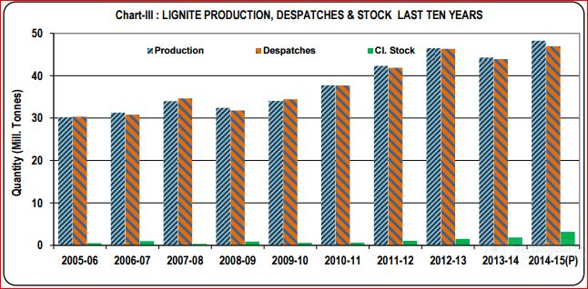
LIGNITE PRODUCTION IN INDIA

Slide 8

A brief about Coal India Limited
Coal India Limited (CIL) is a ‘Maharatna’ Public Sector Undertaking under administrative controls of Ministry of Coal (MoC), Government of India with headquarters at Kolkata, West Bengal, India.
CIL is the single largest coal producing company in the world.

Slide 9
OPERATIONS
CIL operates through 81 mining areas spread over 8 provincial states of India.
Coal India has 430 mines of which 227 are underground, 175 opencast and 28 mixed mines.
CIL also operates 15 coal washeries (12 coking coal and 3 non-coking coal).

Slide 10

COAL INDIA LIMITED : Geographic position
CCL, CMPDI
BCCL
NCL
NEC
CIL Hq.
KOLKATA
ECL
MCL
SECL
WCL

Slide 11
UNDERGROUND MINE MECHANISATION
Based on the geological conditions priority is being given for adoption of Long-wall Technology or deployment of Continuous Miners.
Efforts are also being made to identify suitable prospective sites for application of High-wall Mining which is a mining method to extract coal from an exposed coal seam at the terminating line of an opencast mine or in virgin properties which are neither amenable to opencast nor underground mining exclusively..
SDL (Side Discharge Loader)/ LHD (Load Haul Dumper) as loading machines were introduced in underground mines replacing manual basket loading since early eighties. UDMs (Universal Drill Machines) were also introduced in conjunction with SDLs/LHDs for face blasting and roof bolting.
The population of SDL/ LHD is envisaged to increase from the current level of 1000 nos. to 1500 nos in the mines of CIL during the XII Plan.

Slide 12
UNDERGROUND MINE MECHANISATION (Contd.)
Followings are the list of mines deploying continuous miner/miners for which Project Report has been prepared and approved.
Comp | No of Mines (CMs) | Name of Mines (Capacity, Mty)
ECL | 2 (3) | Kumardih B (1.02 – 2CMs); Kottadih (0.51-1CM)
BCCL | 1 (1) | Block-II(0.45-1CM)
CCL | 4 (5) | Churi-Benti (0.50-1CM); Parej East(0.51-1CM); Piparwar- Mangardaha (1.02-2 CMs.), Amlo-Dhori (0.30-1CM)
WCL | 5 (8) | Jamunia (0.84-2CMs), Dhankasa(0.91–2CMs),Tawa-II(0.36-1CM), Gandhigram(1.17-2CMs),Dhau-North UG (0.36-1CM)
SECL | 5 (6) | *Churcha Re-organisation(1.00–2CMs), Khairaha(0.465-1CM), Haldibari(0.42-1CM), Ketki(0.30-1CM) & Vijay (West)(0.42-1CM)
MCL | 2 (2) | Talcher (West)(0.52-1CM), Natraj(0.52-1CM);
Total CIL | 19 (25CMs) | Total Planned Capacity: 12.595Mty
* In Churcha Re-organization 2 CM equipments have been supplied & is in the process of commissioning.

Slide 13
UNDERGROUND MINE MECHANISATION (Contd.)
Continuous Miner Technology: At Present, 8Continuous Miners are deployed in the following 7 under ground mines of CIL
Subsidiary Co. | No of mines (CMs) | Name of the mines, CM Capacity (Mty)
ECL | 2 (3) | Jhanjra (0.95 – 2CMs) and Sarpi (0.46)
WCL | 1(1) | Tandsi(0.51)
SECL | 4(4) | Kapildhara (0.43), Sheetal Dhara – Kurja (0.42), Pinoura (0.40) and Rani – Atari(0.18)
Total CIL | 7(8) | Total Planned Capacity: 3.35 Mty (8CMs)

Slide 14
UNDERGROUND MINE MECHANISATION (Contd.)
Continuous Miner Technology
In addition, there are mines deploying continuous miner/miners for which Project Report has been prepared but not approved. The lists of these mines are as below:
Subsidiary Company | No. of Mines (CMs) | Name of Mines (CM Capacity , Mty)
ECL | 8(21) | Jhanjra LHCM (0.72 – 2CMs), Tilaboni (1.86 – 4CMs), Shankarpur (1.163 – 2CMs), Pandabeswar-Dalurband (1.17 – 2CMs), Rangamati B (Gourbazar Sector) (0.855 -2CMs), Rangamati B (Tumni & Kanchanpur Sector) (1.08 – 3LHCMs ), Bakulia (1.44 – 4CMs), Siduli (1.02- 2CMs)
BCCL | - | -
CCL | - | -
WCL | - | -
SECL | 1(2) | Pathakpur (0.72 -2 CMs)
MCL
Total CIL | 9(23CMs) | Total Possible Capacity 10.028 Mty
Grand Total (Continuous Miner): 25.973Mty

Slide 15
UNDERGROUND MINE MECHANISATION (Contd.)
Long-wall Technology:
  At present in CIL no PSLW face is in operation. However, one shortwall face at Balarampur mine at SECL is in operation.
  Work orders have already been issued for operating five mines (Jhanjra in ECL, Kapuria, Moonidih (both XV & XVI seam), and Muraidih in BCCL) by long-wall technology.
  Likely capacity addition from these mines will be around 8.9 Mty. The lists of these mines are as below:
Subsidiary | Name of the Mines | Capacity (Mty)
BCCL | Moonidih XVI | 0.7
BCCL | Moonidih XV | 2.5
BCCL | Kapuria | 2.0
BCCL | Muraidih | 2.0
ECL | Jhanjra | 1.7
 | Total | 8.9
Moreover, three mines namely, Nand, Murpar and Borda of WCL have been identified for deployment of PSLW technology. The NIT document for Murpar and Borda mines approved by WCL Board & global bidding is under process. The NIT document of Nand mine is under finalization.

Slide 16
UNDERGROUND MINE MECHANISATION (Contd.)
High-wall Mining:
Coal is extracted by driving a series of parallel entries from the high wall up to a significant depth within the coal horizon. This technology allows recovery of coal blocked in the batter in opencast projects. At present this technology has been implemented in Sharda Opencast project of SECL.
Further for Baturia mine of SECL, this technology has been proposed for which PR has been prepared.

Slide 17
UNDERGROUND MINE MECHANISATION (Contd.)
High-wall Mining:
Coal is extracted by driving a series of parallel entries from the high wall up to a significant depth within the coal horizon. This technology allows recovery of coal blocked in the batter in opencast projects. At present this technology has been implemented in Sharda Opencast project of SECL.
Further for Baturia mine of SECL, this technology has been proposed for which PR has been prepared.

Slide 18

Continuous Miner
It is a mass production technology which gives several advantages over other technologies in bord & pillar method of mining.
  Comparatively higher rate of output
  Integrated system of mining in which all unit operations are mechanised
  Suitable under wide thickness range of coal seams
  Comparatively safer method of mining
Video of CM
Video of Bolter-Miner

Slide 19
Continuous Miner

Slide 20
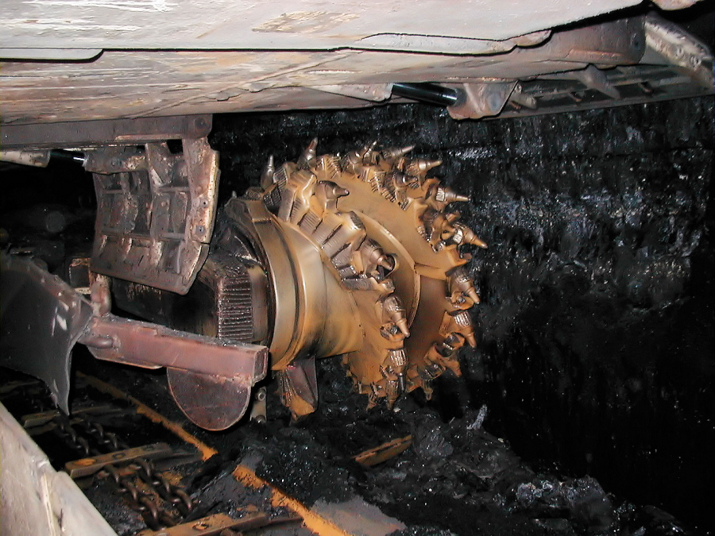
Powered Support Longwall Face

Slide 21
THANK YOU

