Slide 1

Country Presentation
Present Power System in Sri Lanka
SAARC Perspective Workshop on the Past and Future of High Voltage (HVDC) Power Transmission
30th September – 01st October 2015 in
Lahore
Eng. A.L. Z. Hussain (Chief Engineer)
Eng. G.P. Senanayake (Electrical Engineer)
Ceylon Electricity Board
Sri Lanka

Slide 2

General Information of Sri Lanka
Language : Sinhala, Tamil, English
Location : Indian Ocean, South Indian Region
  Altitude : North 60 & 100
  Latitude : East 800 & 820
Land Area : 65,610 sq. km
Capital :
  Administrative : Sri Jayawardenapura
  Commercial: Colombo
Population : 20.675 million (2014)
Literacy : 92.5%

Slide 3
Organization of the Power Sector

Slide 4
Sri Lanka Electricity Data for 2013
Installed capacity - 3,362 MW
Peak Demand - 2,164 MW
Electricity Generated - 11,962 GWh
System losses - 10.79%
Load Factor - 62.8%
Access to Electricity - 96%
Elec. Consumption per Capita - 519 kWh
Avg. Cost per unit (at selling point) - 17.70 Rs/kWh
Avg. selling price - 17.93 Rs/kWh

Slide 5
Enhanced accessibility(2013)
Electrification Level in
December 2013
96%
Enrich Life through Power

Slide 6
Summary of Statistics - Distribution (2014)
  No. of Customers 5.4 Million
  Length of Line
  33 kV - 29,300 km
  11 kV - 2,400 km
  LV Lines(400V) - 127,200 km
  No of Substations
  Primary - 126 Nos.
  Distribution - 26,826 Nos.

Slide 7
National Electricity Demand Forecast (2012-2032)
Year | Demand (GWh) | Gross Losses (%) | Generation (GWh) | Peak Demand (MW)
2013 | 11,104 | 11.6 | 12,566 | 2,451
2014 | 12,072 | 11.6 | 13,502 | 2,692
2015 | 12,834 | 11.6 | 14,509 | 2,894
2016 | 13,618 | 11.5 | 15,388 | 3,017
2017 | 14,420 | 11.4 | 16,270 | 3,193
2018 | 15,240 | 11.3 | 17,171 | 3,383
2019 | 16,075 | 11.1 | 18,087 | 3,556
2020 | 16,937 | 11.0 | 19,030 | 3,731
2021 | 17,830 | 10.9 | 20,010 | 3,920
2022 | 18,754 | 10.8 | 21,023 | 4,125
2023 | 19,713 | 10.7 | 22,072 | 4,287
2024 | 20,707 | 10.6 | 23,159 | 4,499
2025 | 21,737 | 10.5 | 24,284 | 4,717
2026 | 22,813 | 10.4 | 25,458 | 4,948
2027 | 23,932 | 10.3 | 26,677 | 5,187
2028 | 25,101 | 10.2 | 27,949 | 5,369
2029 | 26,318 | 10.1 | 29,273 | 5,625
2030 | 27,581 | 10.0 | 30,645 | 5,893
2031 | 28,899 | 8.0 | 32,079 | 6,171
2032 | 30,258 | 9.8 | 33,555 | 6,461

Slide 8
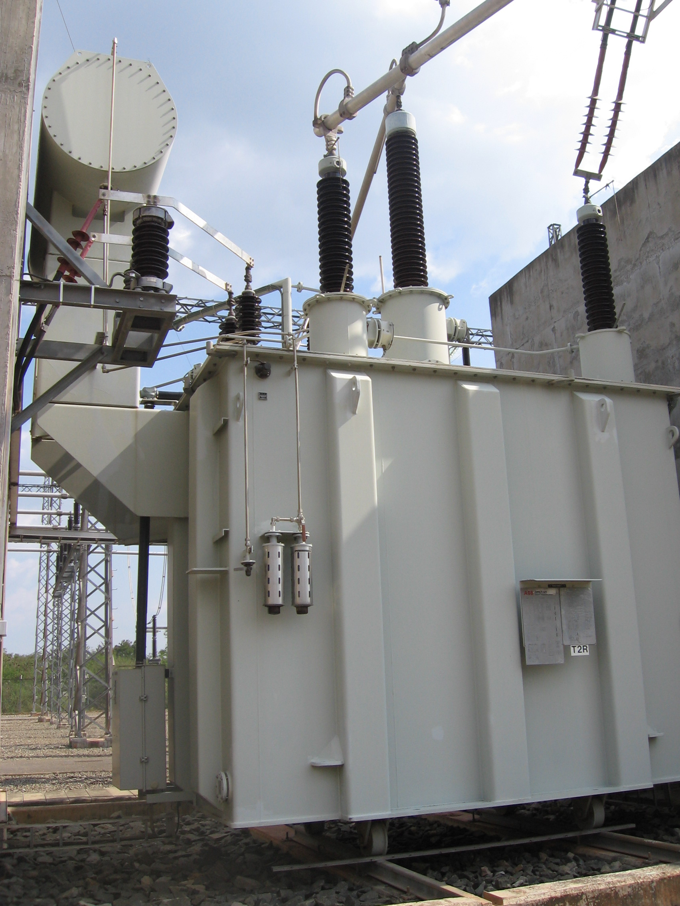
Present Transmission Network -2013
Transmission voltage levels
  220 kV
  132 kV
Transmission Lines/Cables – 2348 km
  220 kV 502 km
  132 kV 1846 km
      OH 1796 km
      UG 50 km
Grid Substations No | MVA
  132/33 kV 48 3045
  220/132/33 kV 5 2100
  220/132 kV 2 405
  220/33 kV 1 70
  132/11kV 5 369

Slide 9
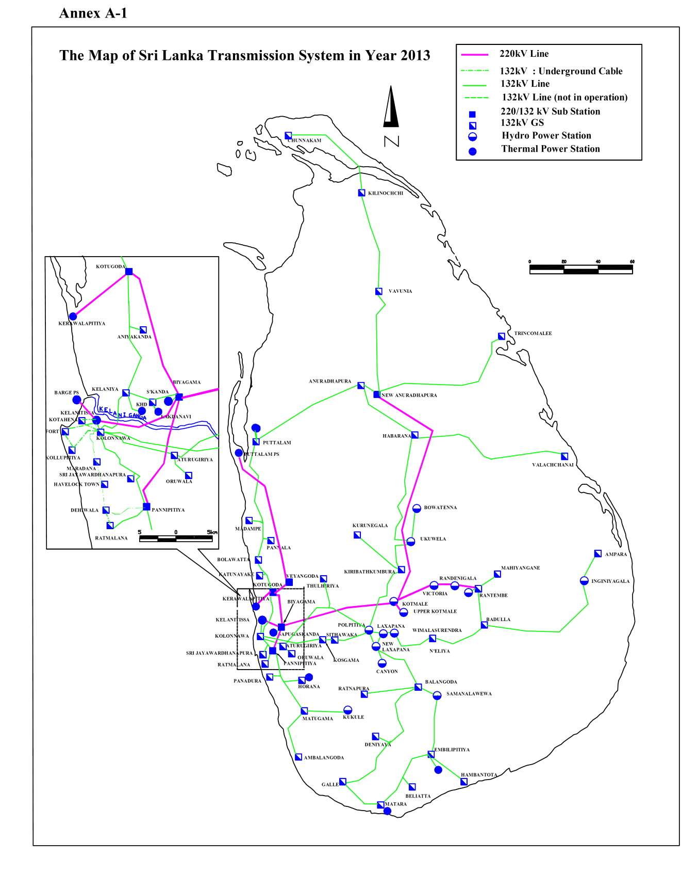
Sri Lankan Transmission System
2013

Slide 10
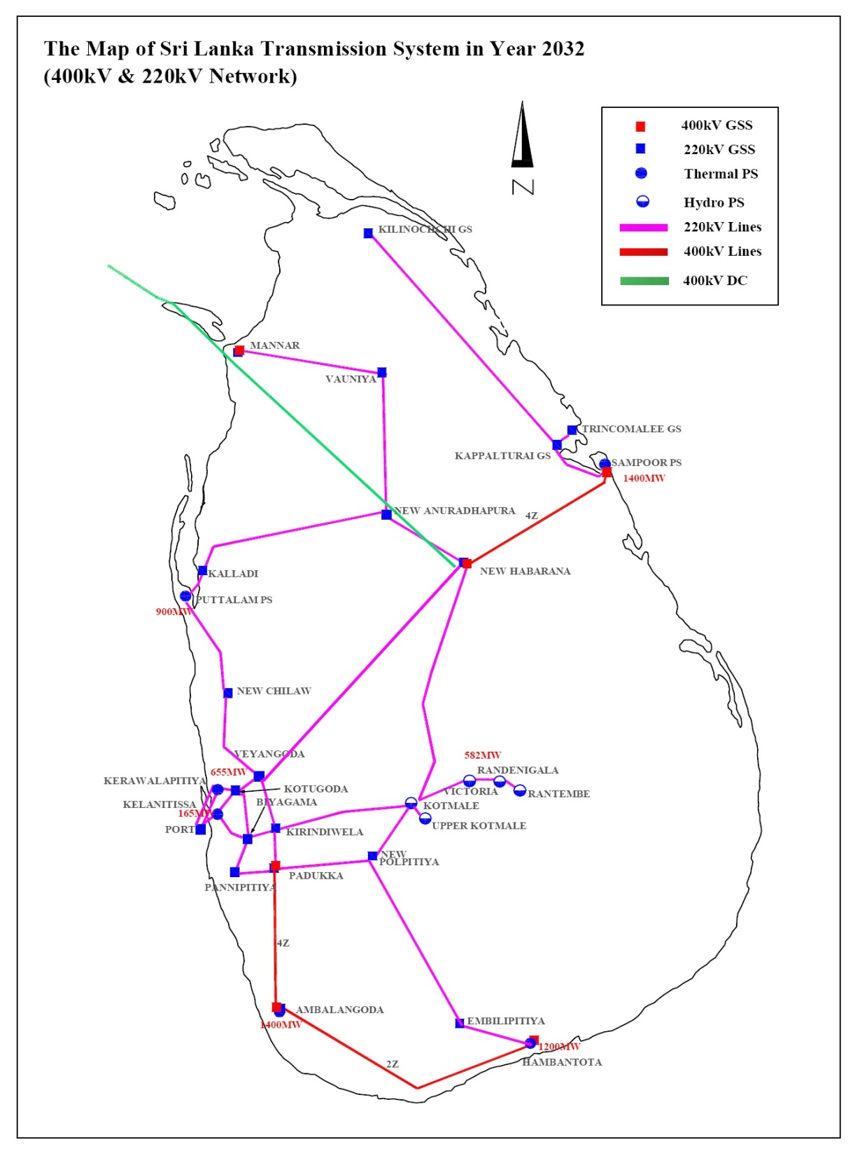
Sri Lankan Transmission System
2032 (planned)

Slide 11
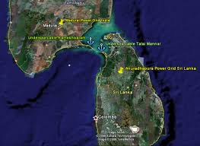
Sri Lanka Cross Border Interconnection with India & Exchange of Power
Notes:
11

Slide 12
Trans-border Electricity Exchange
South Asia Region is very rich in energy resources which are unevenly distributed among the countries of the region.
The advantages of a South Asian Regional Electricity grid are appreciated by almost all countries in the region.
For Sri Lanka to get access to a South Asian Regional Electricity Grid, the only feasible connection is with India through a HVDC marine cable.

Slide 13
Background
Pre-feasibility study conducted with the assistance of USAID in 2002 by Nexant Inc.
Review of the Pre-feasibility study with assistance of USAID in 2006 by Nexant/ Power Grid Corporation of India
Bilateral discussions by Secretary , Ministry of Power and Energy Sri Lanka and Secretary Ministry of Power, India in Dec 2006.

Slide 14
Background…
Cabinet of Ministers approved in principle in Dec 2006, to study the feasibility of power interconnection and to appoint a Steering Committee Co- Chaired by Secretaries of Power Ministries and to appoint a Task Force for technical, commercial, regulatory and legal aspects.
A MOU on Feasibility Study for India- Sri Lanka Electricity Grid Interconnection was signed among GOSL, GOI, CEB and Power Grid Corporation of India Limited (PGCIL) on 9th June 2010.
Executing Agencies; CEB and PGCIL are jointly carrying out the feasibility study

Slide 15
Benefits and Opportunities for
Sri Lanka
Opportunity to enter into India Power Exchange for energy trading
Access to electricity from cheaper sources of power generation in the South Asia Region
Reduction in operational cost through better resource management
Meeting growing power demand with imported power
Improved load profile - valley filling
Improved system reliability and security

Slide 16
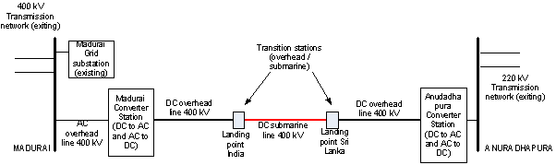
Configuration of the Interconnection

Slide 17
Configuration of the Interconnection
High voltage direct current (HVDC), operating at ±400 kV
Terminal points will be Madurai 400 kV GS in India and Anuradhapura 220 kV GS in Sri Lanka
Total interconnection capacity will be 1000 MW
Total project investment will be in the range 769 and 953 million USD (excluding customs duty and taxes)

Slide 18
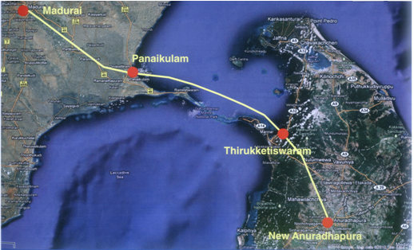
Proposed Line Route
Maduari
130km
Panaikulam
120km
Thiruketis
-waram
110km
A’Pura
overhead
submarine
overhead
  High voltage direct current (HVDC), operating at ±400 kV
  Total interconnection capacity will be 1000 MW

Slide 19
Wholesale Markets in India and Sri Lanka
Indian Wholesale Power Market
  bilateral long-term contracts are dominant
  Two power markets are in operation
  Only 12% of demand served through day ahead and real-time (frequency based, UI) short term market
  Total generating capacity is inadequate to serve the demand
  At times, utilities shed loads when purchase price of electricity in day-ahead and UI market is above a pre-agreed threshold
  Sri Lanka does not have an operational power market
  CEB operates as the single buyer
  Meets customer demand at all times

Slide 20
Ownership Models and Funding
Separately owned predefined portions by PGCIL and CEB
  Soft financing from International lending Agencies. Recovery of costs of interconnection will be added as a fee to the customers of both countries
A company which PGCIL and CEN in partnership
  From lending Agencies on concessionary terms

Slide 21
New Generation Capacity
New power plants in India
  In 2005, state government initiated several coal fired Ultra Mega Power Plants (UMPP)
  three UMPPs, of approx 4000 MW capacity each, are under construction
  No major power plant developments in Southern Region 2, where the interconnection is planned for
  New power plants in Sri Lanka
  Developments follow the long-term plan of CEB
  900 MW Puttalam coal plant available
  500MW Sampur Coal Plant expected to be on line by 2017?
  Almost all future power plants will be either coal or hydro

Slide 22
Potential for Power Exchange Contracts
Short term contracts
  Monthly average prices reported in Indian short term market are in the range of 6.68 to 9.52 UScts/kWh (capacity + energy)
  monthly average purchase prices forecast for Sri Lanka are in the range of 6.50 to 13.46 UScts/kWh (energy only)
  During peak hours, Sri Lanka can make use of the lower cost Indian short term market
  During off peak, the excess coal based generation in Sri Lanka could be sold to the Indian short term market
Long term contracts
  Owing to economies of scale, Sri Lanka signing up with an Indian Ultra Mega Power Plant(UMPP) could be cheaper than building own plants
  Similarly, if Sri Lanka can build an UMPP, it can also serve the Indian base load, owing to the persistent shortfall in India

Slide 23
Power Transfer Costs
Following costs will further reduce any apparent benefits of power exchange between India and Sri Lanka
  Investment and operational costs of the interconnection
  transmission fees of about 0.52 UScts/kWh require to be paid to the Indian grid for transfers within southern grid (based on current regulatory determinations in India)
  energy loss attributed to power transfers between India (southern region) and Sri Lanka (Anuradhapura) amounting to at least 6%

Slide 24
Legal and Regulatory Issues
CEB needs to be empowered to enter into cross-border power transfers
The Transmission and Bulk Supply license held by CEB is required to be amended
Dispute resolution in the Sri Lanka Electricity Act requires to be further strengthened
CEB Act has to be amended to enable the functions of trader or broker, as relevant

Slide 25
To achieve project viability
  The project must be structured as a 1x500 MW monopolar interconnection with no specific assets or commitments now to raise the capacity to 1000 MW
  If the project costs are further reduced by reconsidering the routing options, the 1x500 MW monopolar option has the potential to be viable
  Target project cost for a POWERGRID-CEB joint venture to be profitable is 372.4 MUSD (excluding customs duty and taxes), which at present is estimated to be 554 MUSD
  Both Sri Lanka and India be allowed participation in the wholesale market in each others’ country, with full options and freedom to participate in the short-term, day-ahead and unscheduled interchanges market
  Sri Lankan power system shall relax its maximum load share condition and allow the interconnection to supply at the optimal capacity level

Slide 26
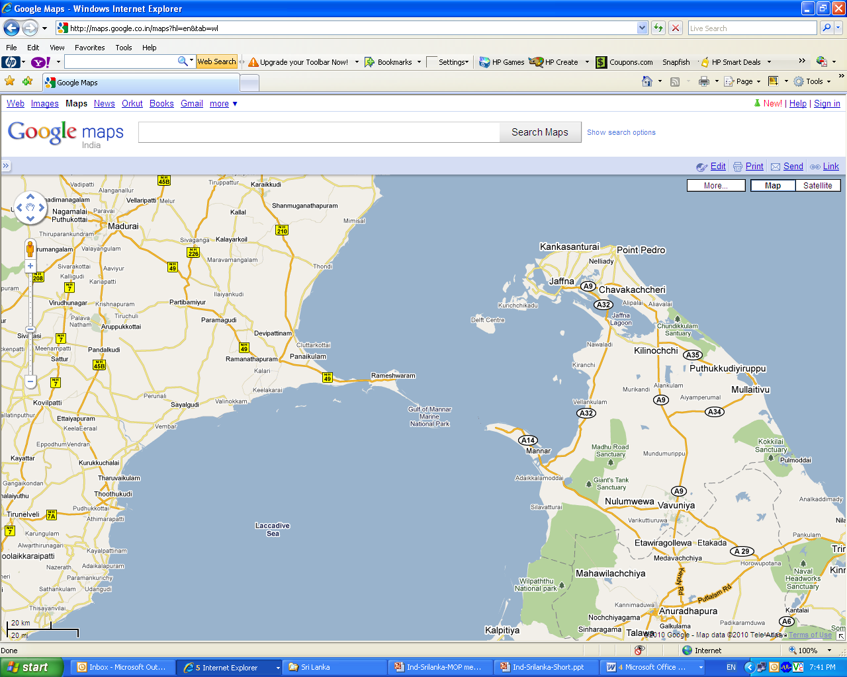
Revised Electricity Grid Interconnection
Madurai
190 km
50km
Thalai Mannar
140 km
New Anuradhapura

Slide 27



