Slide 1




Underground Coal Gasification
26-27 Nov. 2015
New Delhi
P K Jain
IRS, ONGC
SAARC Training Workshop on Sharing Experience
on
CBM, UCG and Coal Extraction Methodology
India’s only Energy Company in Fortune’s ‘World’s Most Admired’ List

Slide 2
Coverage:
UCG Process in general
- Reactions
  - SYNGAS composition
  - Linkage
  - Control
  - Type of Gasifiers
  - Stages in implementation
  - Site selection
  - Site characterization
Utilization of UCG SYNGAS
Indian efforts
Case Histories
33 overseas Assets in 16 countries

Slide 3
Introduction:
Underground coal gasification (UCG) is the process that can recover the energy of coal seams without the extensive use of traditional mining operations
In UCG, the primary product brought from underground is a Combustible fuel gas of low to intermediate heating content, 100 to 300 Btu/standard cubic foot (scf) (884-2676 Kcal/m³)
Highest Dividend-paying Company in India

Slide 4
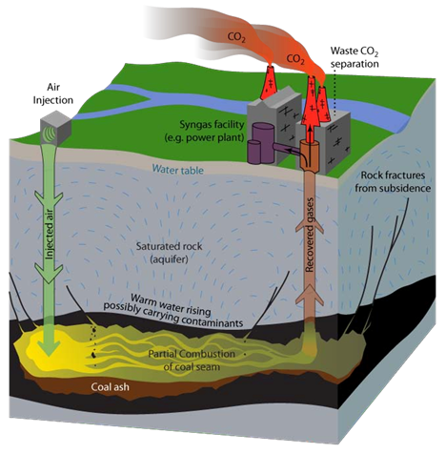
What is Underground Coal Gasification?
Underground coal gasification (UCG) converts coal / lignite in-situ into a gaseous product, commonly known as synthesis gas or syngas.
UCG Process:
  Drilling of adjacent bore holes in the coal seam.
  Down hole ignition of the coal seam.
  Injection of a pressurised oxidant such as air/oxygen and steam.
  Removal of product gas to surface.
World’s Number 3 Exploration & Production Company : Platts

Slide 5
Why UCG???
Growing energy requirement worldwide.
Limited hydrocarbon reserves.
Coal 82% of non-renewables.
India – fourth largest reserves of coal in the world.
Only 20-30% Coal/ lignite mineable. Huge scope for UCG to extract energy from un-mineable coal/ lignite.
Most valuable Indian PSU

Slide 6
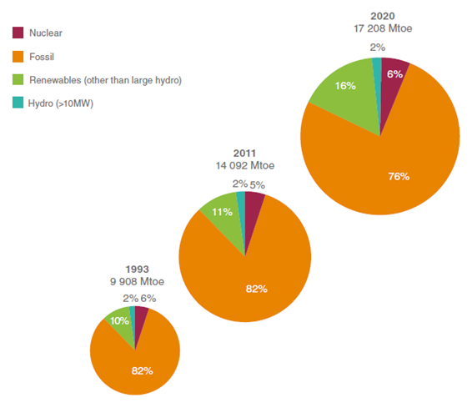
Total Primary Energy Supply by resource 1993, 2011 and 2020 (Source: WEC Survey of Energy Resources 1995, World Energy Resources 2013 and WEC World Energy Scenarios to 2050)
World Energy Scenario:
A FORTUNE Global 500 Company

Slide 7
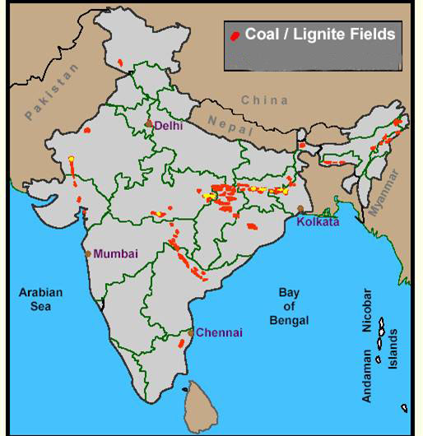
Coal/Lignite resources of India
Coal up to a depth of 1200 m ➔ 306 Bt
Lignite reserves
➔ 44 Bt
World’s Number 3 Exploration & Production Company : Platts

Slide 8
Potential of UCG in INDIA:
UNMINABLE COAL RESOURCES : 245 BT
UNMINABLE LIGINITE RESOURCES : 39 BT
TOTAL UNMINABLE RESOUCES : 284 BT
RESERVES AMENABLE TO UCG : 10 %
RECOVERABLE RESOURCES : 28.4 BT
UCG GAS (considering 2500 m³/ton) : 75 Trillion m³
CALORIFIC VALUE OF PRODUCED GAS : 3 – 5 MJ / m³
NATURAL GAS EQUIVALENT : 7.5 Trillion m³
CALORIFIC VALUE OF NATURAL GAS : 38 MJ / m³
33 overseas Assets in 16 countries

Slide 9
Gasification Reaction:
Coal is gasified underground by injecting air or oxygen/steam through Boreholes into a reaction zone formed in the coal seam. The hot gaseous reaction products are Forced to migrate though the coal seam to an exit borehole where they are drawn form underground to the surface. Upon reaching the surface, the gases can be cleaned for direct use as a low-to-medium Btu gas, from upgrading to a substitute natural gas (SNG), or for some other chemical feedstock (SynGas).
Condensate consisting of phenol, tar, ammonia, carbonic acid, fatty acid, pyridine cynide and thio- cynate etc. is also produced along with syngas
Fig. Schematic representation of an underground coal gasification reaction zone
ONGC a Wealth Creator
Notes:
Condensate consisting of Phenol, Tar, Ammonia, Pyridine cyanide and Thayo cyanide etc. is also produced.

Slide 10
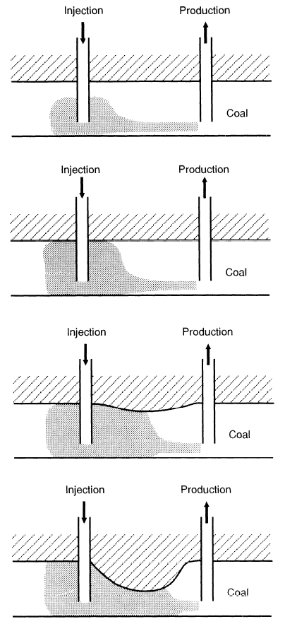
Growth of UCG Cavity:
33 overseas Assets in 16 countries

Slide 11

Linking of UCG wells:
World’s Number 3 Exploration & Production Company : Platts

Slide 12
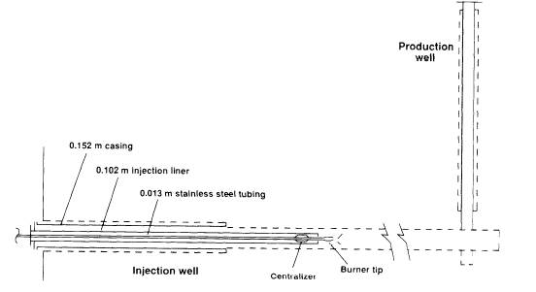
Ignition of the Coal:
O₂ thru Large dia tube.
Inert gas N₂ thru small dia tube.
A slug of silane (pyropheric gas) behind the N₂.
Methane after silane.
Silane in contact with O₂, flame starts.
A FORTUNE Global 500 Company

Slide 13
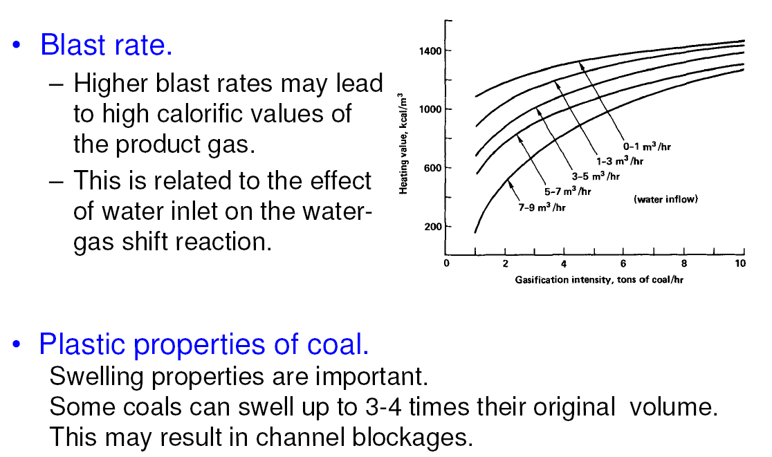
Control parameters – Water, Blast rate
# 21 Energy Company in the World

Slide 14
Cont…
Effect of gasification rate and water intrusion rate on the heating value of the product gases
Excess water alters the heating value by decreasing the temp. and rate of char reactions and hence altering the gas composition
Effect of gasification rate on heating value at various water injection rates (Edgar and Gregg, 1981). Conversion factor: 1 lb = 0.4536 kg, 1 Btu/ft³ = 37.26 kJ/m³, 1 ft³ = 0.02832 m³.
World’s Number 3 Exploration & Production Company : Platts

Slide 15
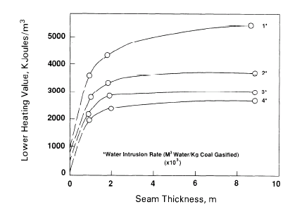
Effect of Seam thickness and Water intrusion on Heating value:
Heat loss from an underground reaction zone to surrounding rock strata is expected to vary inversely with coal seam. In thin seams, temp. may be lower and reaction rates lower. Soviets studies suggest that heating value of the product gas deteriorates rapidly for those seams less than 6’ and gasification cannot sustain in seams less than 3’.
Effect of seam thickness and water intrusion on UCG heating values (Anonn., 1977). Conversion factors: 1 ft = 0.3048m, 1 Btu/ft³ = 37.26 kJ/m³.
ONGC a Wealth Creator

Slide 16
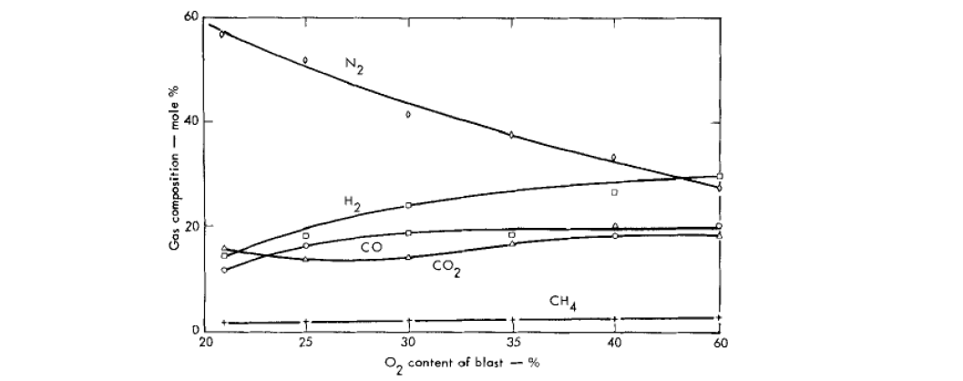
Control parameters – Air OR Oxygen
The use of Oxygen instead of air:
Improves the Calorific Value (CV) of the Product gas, 3-5 MJ/m³ Vs. 13 MJ/m³ in the trial at EI Tremedal.
Improves gasification stability.
Reduces the volume of gas injected.
#2 E&P Company in the world

Slide 17
Operating Pressure
From an UCG gas generator, at constant air injection rate, a linear relation between gas loss and the difference between the square of the absolute pressure (averaged over the reaction zone) and the square of the atmospheric pressure.
The slope, site specific, is proportional to the permeability of the seam.
Dependence of the relative value of the gas losses on the gas pressure in an underground gas generator (Pitkin, 1960).
A FORTUNE Global 500 Company

Slide 18
Combustion and gasification products:
Most valuable Indian PSU

Slide 19
Quality of Product gas:
Oxidising agent (air/ oxygen)
Operating Pressure & Temperature
Feedstock composition
Seam thickness
Moisture content of coal
Oxygen to steam ratio- reducing ratio improves H₂ and CH₄ while increasing ratio improves CO and CO₂.
33 overseas Assets in 16 countries

Slide 20
Breakthrough of Air/ Oxygen
Sometimes oxygen in the injected air gets mixed with the product gases prior to it being exhausted from underground , thereby lowering its heating value and also increasing temp. of the production well. The breakthrough or bypass of air/ oxygen often signifies the end of the useful life of the UCG generator.
The data shown are for Hanna II experiment, Heating value and temp. as the function of time.
World’s Number 3 Exploration & Production Company : Platts

Slide 21


Composition of typical dry UCG product gas:
(Spanish Trial-Gasification with Oxygen)
(Angrenskaya – Gasification with Air Injection)
(Calorific Value 13.6MJ/Nm³)
(Calorific Value 3.5 MJ/Nm³)
#2 E&P Company in the world

Slide 22
UCG syngas vs SCG syngas
UCG product gas is similar to surface gasifier product. Higher CO₂ in UCG signifies the breakthrough of O₂.
World’s Number 3 Exploration & Production Company : Platts

Slide 23
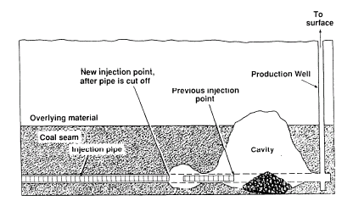
Basic design of the controlled retracting injection point (CRIP) system (Hill and Shannon, 1981)
CRIP (Controlled Retracting Injection Point):
Most valuable Indian PSU

Slide 24
Carbon Energy Bloodwood Trial:

Slide 25
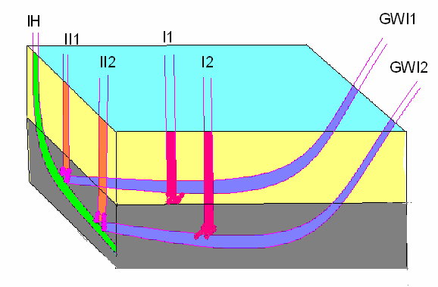
Schematic Diagram of a Pilot:
#2 E&P Company in the world

Slide 26
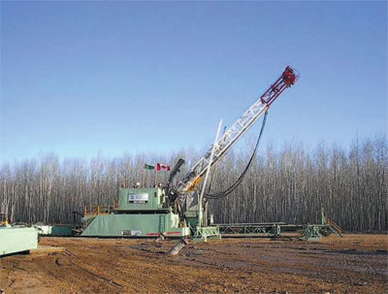
SLANT RIG

Slide 27
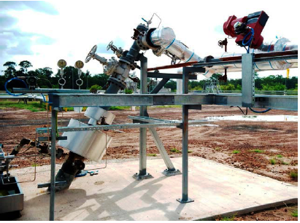
Wellhead:

Slide 28
How to Proceed
for
UCG Implementation

Slide 29
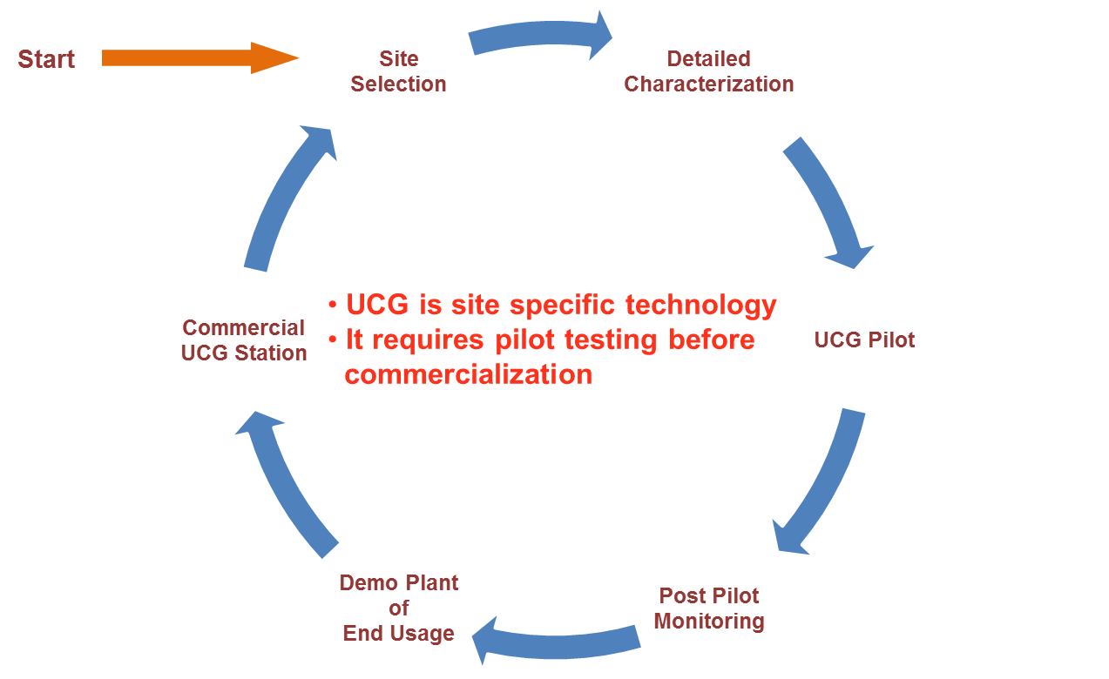
UCG implementation Diagram:
Most valuable Indian PSU

Slide 30
UCG Site Criteria:
Criteria for a suitable UCG site location:
- Geology is key to safeguard environment
- Geologically isolated deep beds
- Deep aquifers should consist of saline, non- potable water & have stratigraphic seals
- Structural integrity & no possibility of cavity roof caving
Most valuable Indian PSU

Slide 31
Site Selection:
Factors:
Seam thickness
Depth
Coal rank
Ground water
Coal reserve
A FORTUNE Global 500 Company

Slide 32
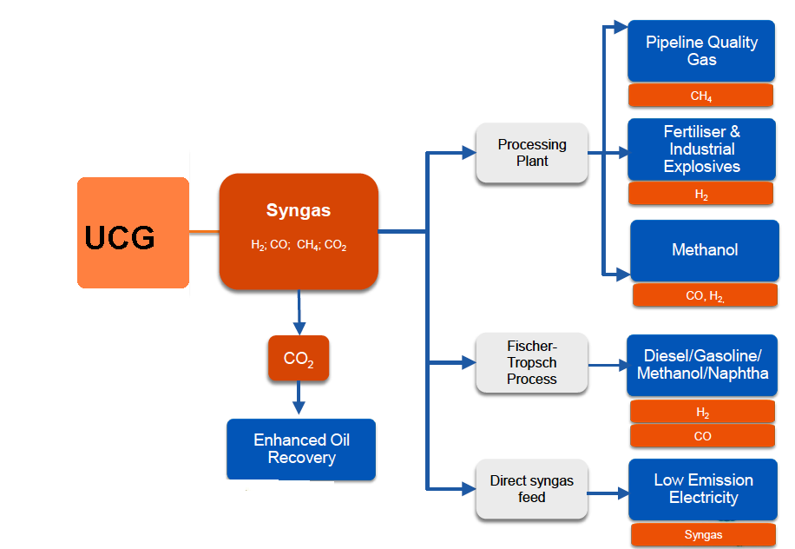
End usage of SYNGAS:
#2 E&P Company in the world

Slide 33
Utilization of UCG SYNGAS:
Primary product with air as oxidant: low BTU gas, best suited for onsite or near site use as a fuel for boilers, heaters, power generators, and kilns. (80-150 btu/scf )
As low heating value fuel, contains a sizable quantity of inert N2, and hence not cost effective for pipe transportation beyond 1 mile. For onsite use, it is a good source of heat.
Oxygen/ steam : Medium heating value (200-300 btu/scf)- Absence of N2, gas suitable for upgrade thru chemical processing to SNG and/or to several synthesis gas compositions:
# 21 Energy Company in the World

Slide 34
Up-gradation of Ucg syngas for different end usages:
World’s Number 3 Exploration & Production Company : Platts

Slide 35
General Engineering design for Pilot :

Slide 36
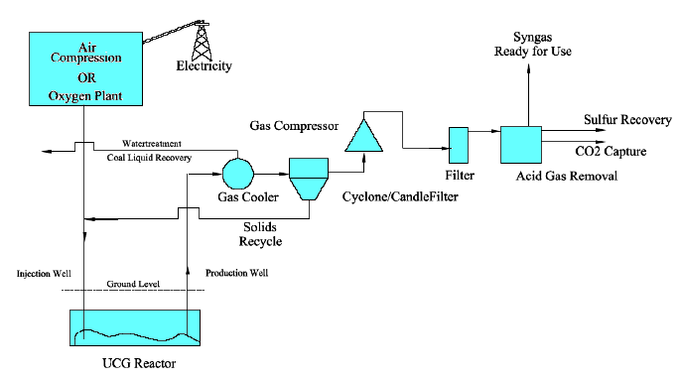
Basic Processing of SYNGAS:
A FORTUNE Global 500 Company

Slide 37
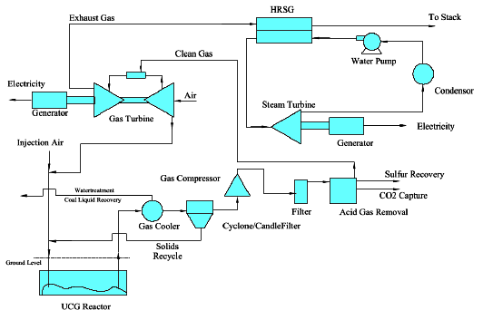
UCG – IGCC Power Plant:

Slide 38
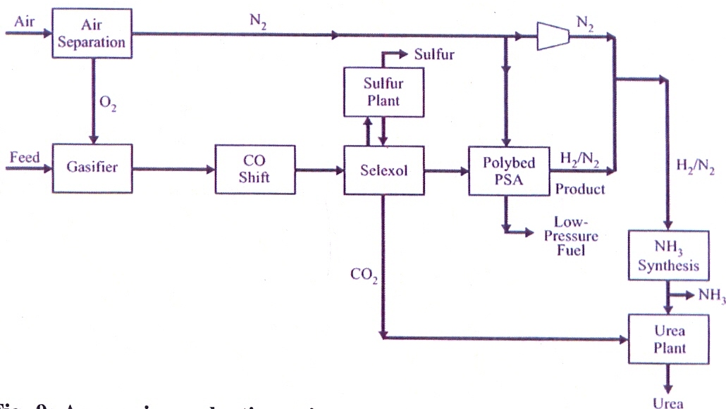
Ammonia Production:

Slide 39
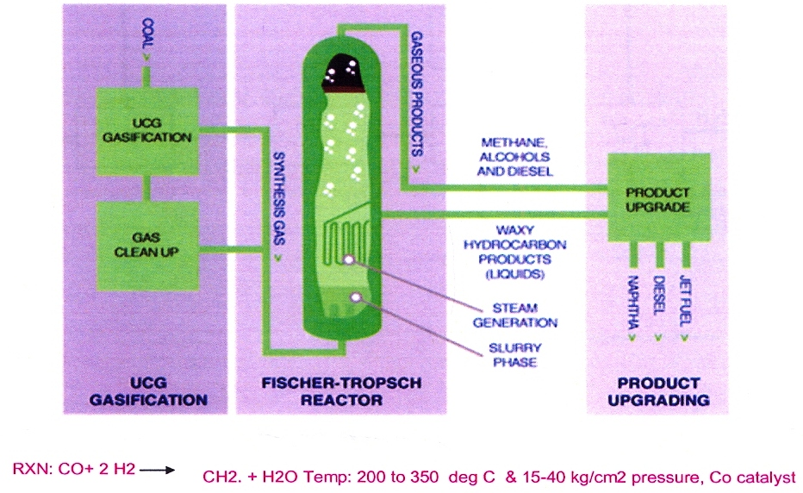
Fischer Tropsch Process:

Slide 40
Indian efforts:
Various companies ONGC, CIL, GIPCL, GMDC, NLC are associated with UCG.
5 Sites (lignite) identified suitable for UCG by ONGC.
Vastan (Gujarat ) lignite block prioritize for UCG pilot.
Detailed Engineering design for pilot is in hand
Block has been awarded by MoC to GIPCL.
ONGC and GIPCL are in process for field trial.

Slide 41
Case Histories:

Slide 42
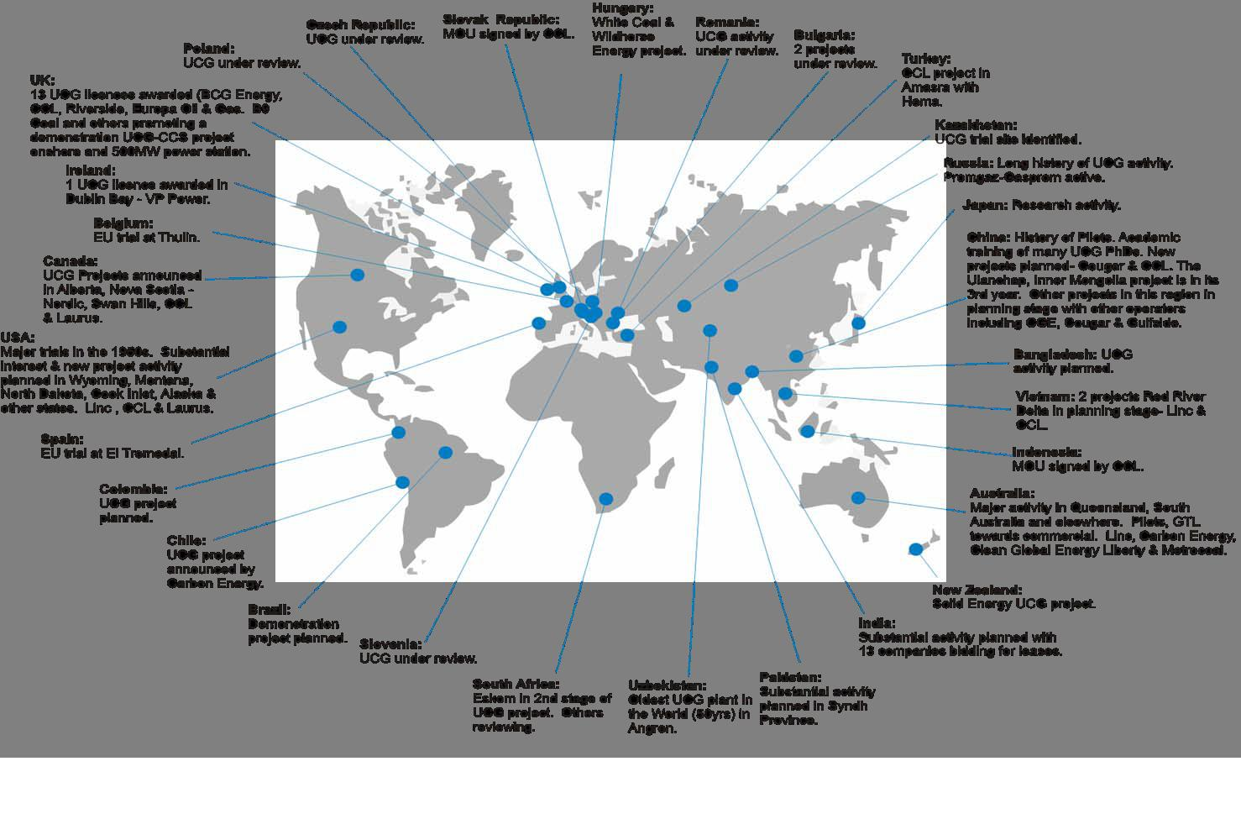
UCG – International Scenario 2010:
A FORTUNE Global 500 Company

Slide 43
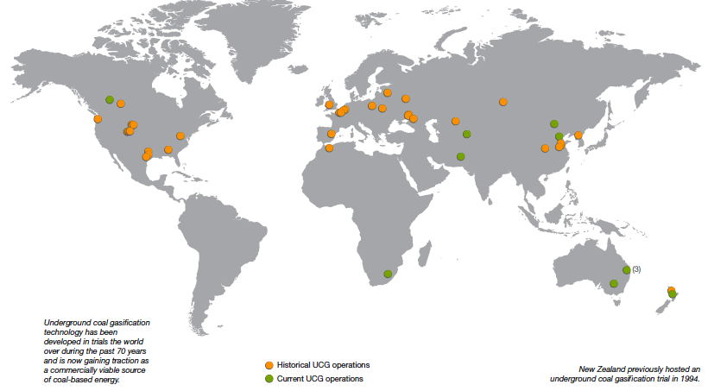
UCG – Worldwide Sites:
World’s Number 3 Exploration & Production Company : Platts

Slide 44
Worldwide UCG Experience
Coal Seam Depth & Thickness:
A FORTUNE Global 500 Company

Slide 45
Current UCG Projects:
Chinchilla UCG project by Linc Energy in Australia.
Carbon Energy UCG project at Surat Basin, Australia.
Eskom Plant in South Africa.
Angren, Uzbekistan Commercial project.
UCG Pilot at Thar, Pakistan

Slide 46
Chinchilla UCG project by Linc Energy in Australia:
UCG process started in 1999
The salient features of the UCG process are as follows:
35000 tonnes of coal gasified- more than in any other UCG trial. Within the Rocky Mountain 1 trial- considered the most successful UCG trial in the United States- only 10,000 tonnes were gasified.
80 million Nm3 of gas produced at 4.5-5.7 MJ/m3.
A maximum capacity of 80000 Nm3/hr or 675 tonnes of coal per day was reached at the Chinchilla plant. In comparison, the Rocky Mountain 1 trial achieved a maximum gasification rate of 200 tonnes of coal per day.
The Chinchilla trial proved availability of gas production over 30 months-by far the longest ever recorded outside the ex-USSR.

Slide 47
UCG projects in Australia:
4 gasifier panels studied.
Directional wells (1 km long) for linkage.
Coiled tubing used for drilling.
Trial with oxygen carried out.
Demo FT facility for aviation fuel using UCG syngas.
De-commissioning of the process –Environment agency vigilant.
Carbon Energy made trial in Blood wood site with oxygen, waiting for permission from Environment agency for commercialization.

Slide 48
Thar-Pakistan:
Thar Block
Lignite reserves: 185 BT, Area: 900 Sq Km, Depth-122-180 m, thickness: 0.3-42 m, Avg. thickness: 21 m
No. of blocks: 12, Two (3 & 5) allocated for UCG
Block 5: 64 sq km, Reserves: 1.4 BT
- 4 coal seams below the casing depth, thickness 0.86 m to 3.58 m, 4 coal seams above the cased depth (130-145 m)
Most valuable Indian PSU

Slide 49
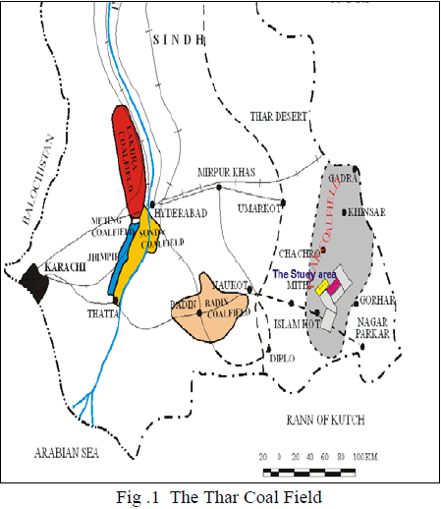
Thar-Pakistan:

Slide 50
Thar-Pakistan:
Initially planned directional drilling, drilling price quoted was 4 times that of whole of the gasifier
Decided to drill vertical wells with reverse combustion technique for linking, total of 36 wells with spacing of 25-30 m as reverse combustion gives satisfactory results in this range
Drilling with 15” bit for 8 ½” OD casing, casing cemented behind to isolate water aquifers at the depth 180-300 ft.
Pilot operated in Dec.’2011
Agencies involved: (i) Pakistan Atomic Energy Commission (PAEC)
(ii) National Engineering & Scientific Commission
(NESCOM)

Slide 51
Difficulties faced
Thar-Pakistan:
In few of the wells of gasifier water aquifer could not be isolated after cementation of the casing
Water level could not be brought down even after excessive pumping
Problematic wells were identified through pump tests and excluded from gasifier

Slide 52
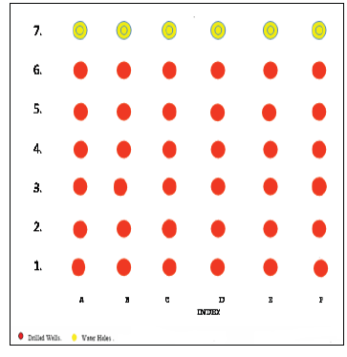
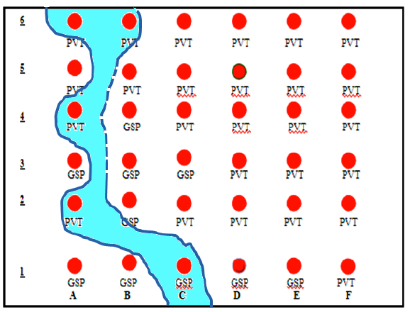
Thar-Gasifier Layout
52
Permeable water bearing body as intercepted in the gasifier wells
Layout plan of the gasifier

Slide 53
Thar-Pakistan Future Plan:
As per media reports, funds have been approved by Pak Govt. for trial for 10 MW power production
Based on the above results, 100 MW electricity planned to be produced after 3 yrs (As per syngas refiner dated 31st may 2012)

Slide 54


Thank You...

